Slide 1

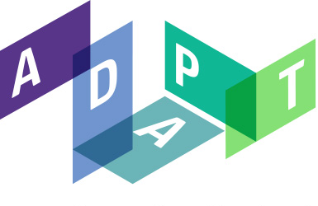

8th International Workshop on
Linked Data in Architecture and Construction
Hosted from Dublin, Ireland
Kris McGlinn, Markus Helfert, Declan O’Sullivan
Pieter Pauwels, María Poveda-Villalón, Jakob Beetz,
Ana Roxin, Mads Holten Rasmussen, Anna Wagner
http://linkedbuildingdata.net/ldac2020/

Slide 2
Welcome to LDAC

Slide 3
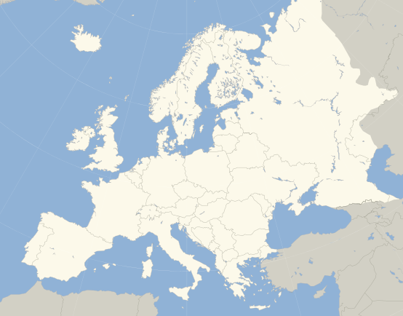

LDAC Track
LDAC2012, Ghent
LDAC2014, Helsinki
LDAC2015, Eindhoven
LDAC2016, Madrid
LDAC2017, Dijon
LDAC2018, London
LDAC2019, Lisbon
LDAC2020, Dublin
LDAC2014
LDAC2020
LDAC2018
LDAC2015
LDAC2012
LDAC2017
LDAC2019
LDAC2016

Slide 4
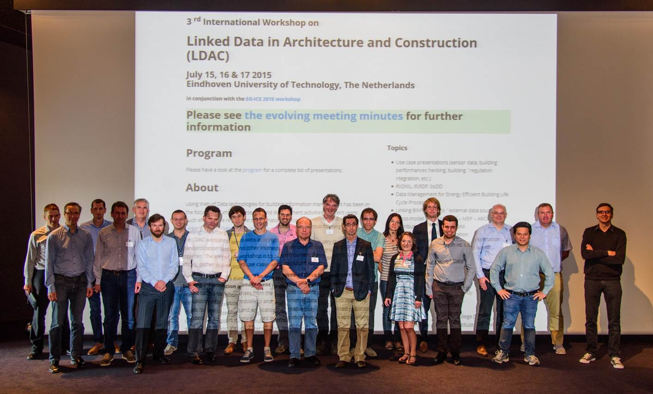

Slide 5
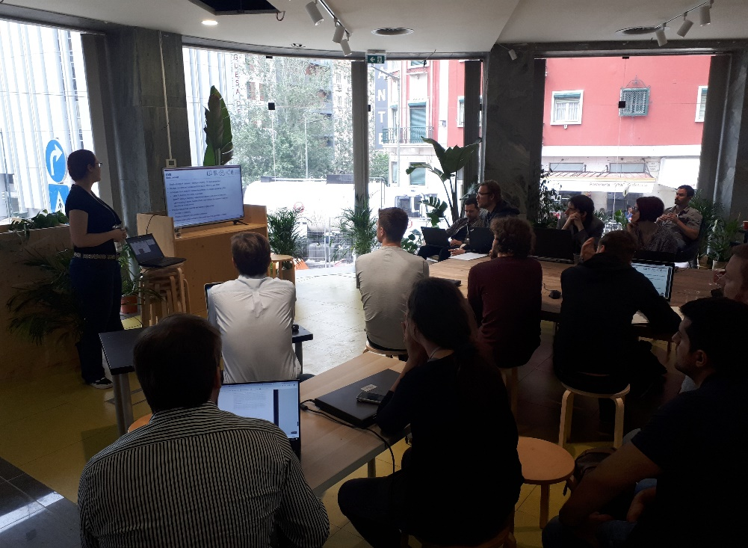

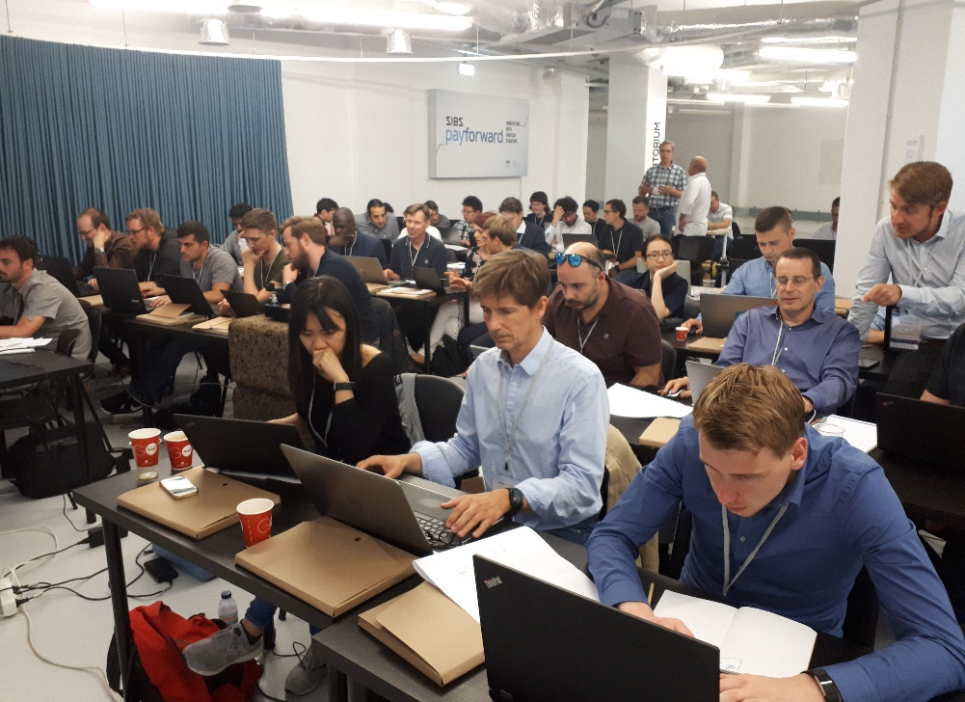



LDAC 2019 - Lisbon

Slide 6


Slide 7
LDAC2020 Program

Slide 8
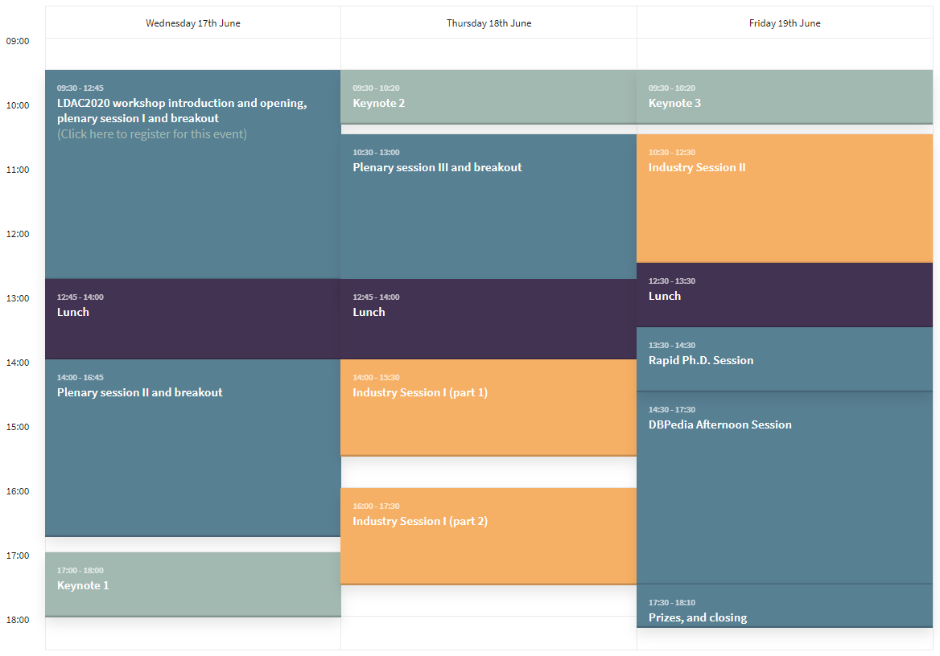
http://linkedbuildingdata.net/ldac2020/ldac_program/

Slide 9
Program Wednesday
(All times given in CEST)
09:30 – 10:00: LDAC2020 workshop introduction and opening
10:00 – 12:00: plenary session I (Pieter Pauwels)
  From obXML to the OP Ontology: Developing a Semantic Model for Occupancy Proﬁle
  Serge Chavez-Feria, Giorgos Giannakis, Raul García-Castro, and María Poveda-Villalón
  Linked Data for Smart Homes: Comparing RDF and Labeled Property Graphs
  Alex J. A. Donkers, Dujuan Yang, and Nico Baken
  Towards deﬁning Data Usage Restrictions in the Built Environment
  Gonzalo Gil and Iker Esnaola-Gonzalez
  Design and integration of the project-specific ontology for data analytics support
  Miloš Šipetić, Reinhard Jentsch, Judit Aizpuru, and Jan Kurzidim
12:15 – 12:45: plenary I break out sessions
12:45 – 14:00: Lunch
14:00 – 16:00: plenary session II (Jakob Beetz)
  A GIS-based Ontology for Representing the Surrounding Environment of Buildings to Support Building Renovation
  Maryam Daneshfar, Timo Hartmann, Jochen Rabe
  Integration of BIM-related bridge information in an ontological knowledgebase
  Al-Hakam Hamdan and Raimar J. Scherer
  Validation of IfcOWL datasets using SHACL
  Sander Stolk and Kris McGlinn
  ifcOWL-DfMA a new ontology for the offsite construction domain
  Edlira Vakaj and Franco Cheung
  16:15 – 16:45: plenary II break out sessions
  17:00 – 18:00: Keynote I (Juan Sequeda)

Slide 10
Program Thursday
(All times given in CEST)
09:30 – 10:20: Keynote II (Laura Daniele)
10:30 – 12:00: plenary session III (María Poveda-Villalón)
  Pattern-based access control in a decentralised collaboration environment
  Jeroen Werbrouck, Ruben Taelman, Ruben Verborgh, Pieter Pauwels, Jakob Beetz, and Erik Mannens
  Common Data Environments for the Information Container for Linked Document Delivery
  Madhumitha Senthilvel, Jyrki Oraskari, and Jakob Beetz
  Mapping IFC and GIS conceptual schemas via Ontologies
  Elio Hbeich and Ana Roxin
  12:30 – 13:00: plenary III break out sessions
12:45 – 14:00: Lunch
14:00 – 15:30: Industry session I (part 1) (Mads Holten Rasmussen)
  General, using linked data solutions to integrate the construction industry
  John Egan (BIMLauncher)
  General, data communication between disparate design applications using Neo4J and GraphQL
  Will Reynolds (Hoare Lea)
  ISO 23386 and ISO 23387 – methodology to provide an unambiguous definition of properties, using a standardized data structure through data templates, to describe the characteristics of construction objects.
  Espen Schulze (Cobuilder)
  16:00 – 17:00: Industry session I (part 2) (Mads Holten Rasmussen)
  Product data, integration between manufacturer data and building models using linked data in compliance with ISO 23386
  Nicolas Bus (CSTB)
  Fire, FireGraph knowledge graph utilizing LBD ontologies
  Bart van Leeuwen (Netage B.V.)
  General, on the need for "more lenses to view the same data", connecting structured and unstructured data and making it available using structures defined in ISO 81346
  Philipp Dohmen (Amberg Group)

Slide 11
Program Friday
(All times given in CEST)
09:30 – 10:20: Keynote III (Ali Intizar)
10:30 – 12:30: Industry Session II (Ken Enright)
  Data integration, FM, practical use case from schiphol airport, asset data management
  Jan Voskuil (Taxonic)
  Infrastructure, roads, Bjørnafjorden Open Live Centre (BOLC) and the V440 ontology
  Lars Wikström (Triona AB)
  Smart buildings, integration between a maintenance management system and a SCADA
  Eduardo Gilabert (Tekniker)
  Smart buildings, Google's own real estate, brick, haystack
  Charbel Kaed (Google)
  12:30 – 13:30: Lunch
14:30 – 15:30: Rapid Ph.D. Session (Ana Roxin)
  15:30 – 17:00: DBPedia Workshop (Beyza Yaman)
  DBPedia Opening Session (1 hour)
  Geospatial & Construction Session (45 mins)
  Data Quality Session (45 mins)
  17:00 – 17:30: Closing session

Slide 12
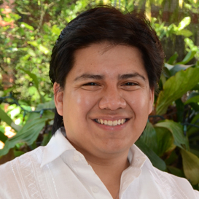
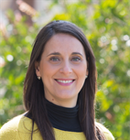
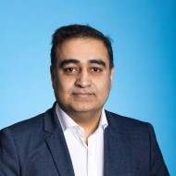
Keynotes
Juan F. Sequeda
data.world
Laura Daniele
TNO
Ali Intizar
Insight Centre
The Socio-technical Phenomena of Data Integration and Knowledge Graphs | The Smart Appliances REference Ontology (SAREF), its development and its application. | History of the Semantic Web, and some words about the future of AI
Data Integration has been an active area of computer science research for over two decades. A modern manifestation is as Knowledge Graphs which integrates not just data but also knowledge at scale. Tasks such as schema and ontology matching, data virtualization, etc., are fundamental in the data integration process. Research focus has been on studying this phenomena from a technical point of view (algorithms and systems) with the ultimate goal of automating the task of integrating data. In the process of applying scientific results to real world enterprise data integration scenarios to design and build Knowledge Graphs from enterprise databases, we have experienced numerous obstacles. In this talk, I will share insights about these obstacles. I will argue that we need to think outside of a technical box and further study the phenomena of data integration with a human-centric lens: from a socio-technical point of view. | In this talk I will take you into a journey that started in 2014, when the European Commission launched the first initiative to build a common ontology in close collaboration with the smart appliances industry, which resulted into the creation of the Smart Appliances REFerence ontology (SAREF). The SAREF framework is maintained and evolved by experts from several European organizations that successfully collaborate with each other and can count on the continuous support of ETSI and the European Commission. During the talk I will share with you the lessons learned during this journey and the challenges ahead, addressing questions and curiosities, like what makes SAREF a successful story, how to keep an ontology relevant to the industry and its community of users, how to consistently maintain and evolve extensions in various domains, but also more specific topics for the LDAC community, such as how to model buildings and different domains related to buildings, how to link SAREF to other domains, and what are the challenges when concretely using the ontology to develop large scale real applications, especially when going across-domain like the Interconnect project aims to do when combining the different domains of smart homes, buildings and grids | Due to the rapid advancements in the sensor technologies and IoT, we are witnessing a rapid growth in the use of sensors and relevant IoT applications. A very large number of sensors and IoT devices are in place in our surroundings which keep sensing dynamic contextual information. The process of getting value from sensor data streams and converting these raw sensor values into actionable knowledge requires extensive efforts from IoT application developers and domain experts. In this talk, we will discuss various approaches for designing intelligent IoT applications and building real-time data analytics pipeline. We will present a common framework to design and build data analytics based IoT applications. We will discuss different challenges at each of the data processing layer of IoT data analytics pipeline and how a combination of modern technologies such as data analytics (machine/deep learning algorithms), semantic Web, Linked Data and AI can help address these challenges. A few example use-cases from smart cities, Industry 4.0 and construction domains with emphasis on digital twins will be presented in detail to demonstrate the utilisation of real-time IoT data analytics pipeline for building intelligent IoT applications.

Slide 13
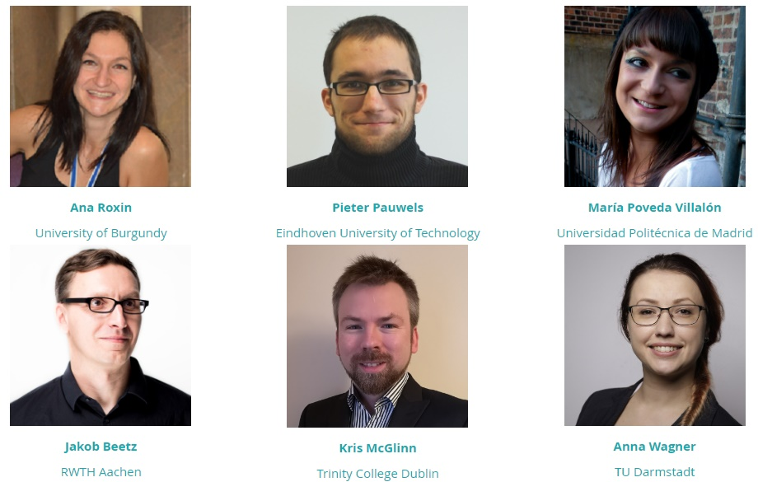
LDAC Committee
Planning and overall organization
Reviews and publication
Program
Keynotes
Virtual platforms :)

Slide 14
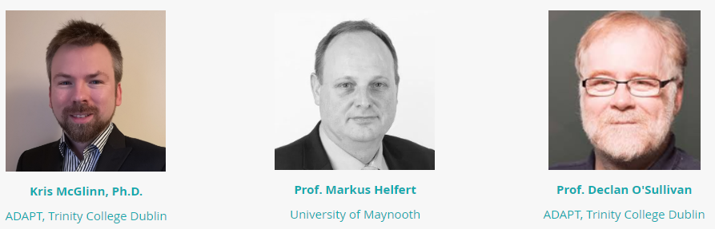
Local Committee
Logistics, registration, financials and sponsoring
Social events
Advertisement
Virtual platforms :)

Slide 15
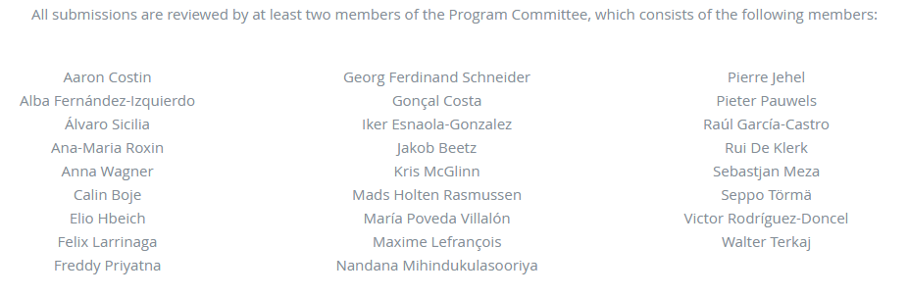
Program Committee

Slide 16
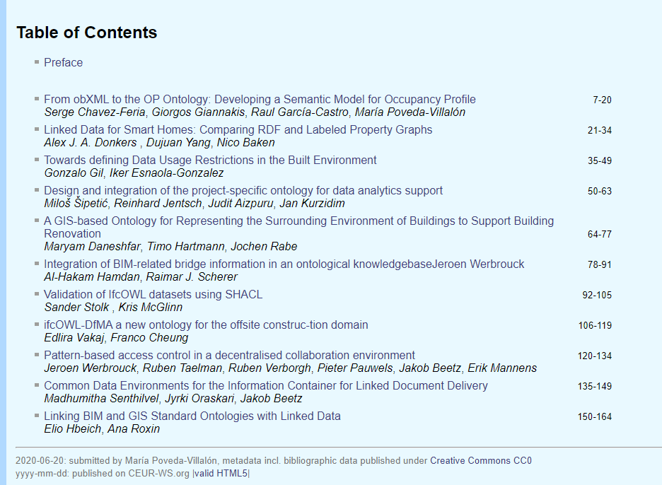
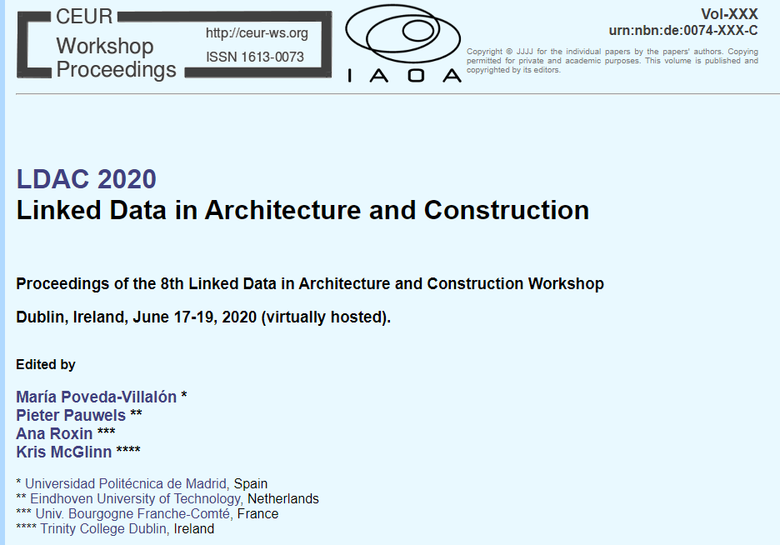
Proceedings in CEUR-WS
Open
Creative Commons CC0
Online
IAOA-supported

Slide 17
Supported by…

Slide 18




SFI ADAPT Research Centre
HQ in Trinity College Dublin
8 Universities across Ireland
Funded Through:
Science Foundation Ireland
EU Awards
Industry
Research in Depth:
AI/Machine Learning
HCI
NLP/Machine Translation
Knowledge and Data Engineering
Proud supporters of LDAC!
NUI Galway
Athlone IT
NUI Maynooth
70 Principle Investigators & Academic Investigators
300 Researchers & Centre Staff
Cork IT

Slide 19


Turn your Data into Knowledge
Notes:
Intro yourself (name, title and what you do at Stardog)
Intro Stardog: Stardog is the Enterprise Knowledge Graph platform that unifies your data. Knowledge graph = graph + Inference + Virtualization

Slide 21
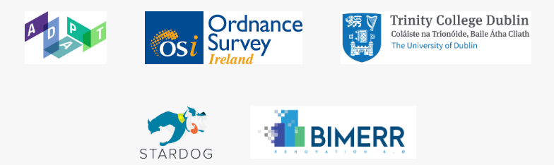

Support

Slide 22
Practicalities and house rules

Slide 23
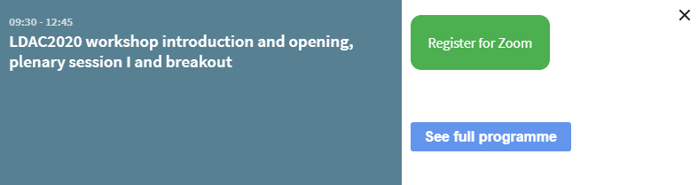
Register for individual sessions
http://linkedbuildingdata.net/ldac2020/ldac_program/

Slide 24
Online material, Zoom, and complete detail
Website:
  will remain to be updated: www.linkedbuildingdata.net/ldac2020
  Presentations - Papers
Detailed Information Sheet
  https://linkedbuildingdata.net/ldac2020/information_sheet.pdf
During Zoom:
  Asking questions: Please post any questions in the public IM window on Zoom, or directly to the moderators (who will be listed at the top of the Zoom call as “hosts”).
  Host moderator will have name “Pieter Pauwels [moderator]”

Slide 25
Breakout sessions
For each plenary session we will have a 30 minutes break out session where we encourage further discussion and interaction.
One breakout room for each paper presentation
Moderators:
  1 paper presenter
  1 LDAC Committee Team member
Breakout rooms on request => Ask in the #breakout channel in Slack

Slide 26
How do break out sessions work?
You enter a Zoom session via the Zoom link to the “Main room”
The main room serves as a hallway from which you can enter any break out room you would like to be in.
The main room displays on screen which break out rooms are available
The main room has two hosts (LDAC Team) who will assign you to break out rooms, based <only> on your name
You vote by changing your name to “<your name> [Room 1]”
  e.g. “Kris McGlinn [Room 1]”
You will then be assigned to a room at breakout. You may change room by editing your name again and returning to the main lobby
  e.g. “Kris McGlinn [Room 2]”
You leave when you want, but sessions last max 30min.

Slide 27
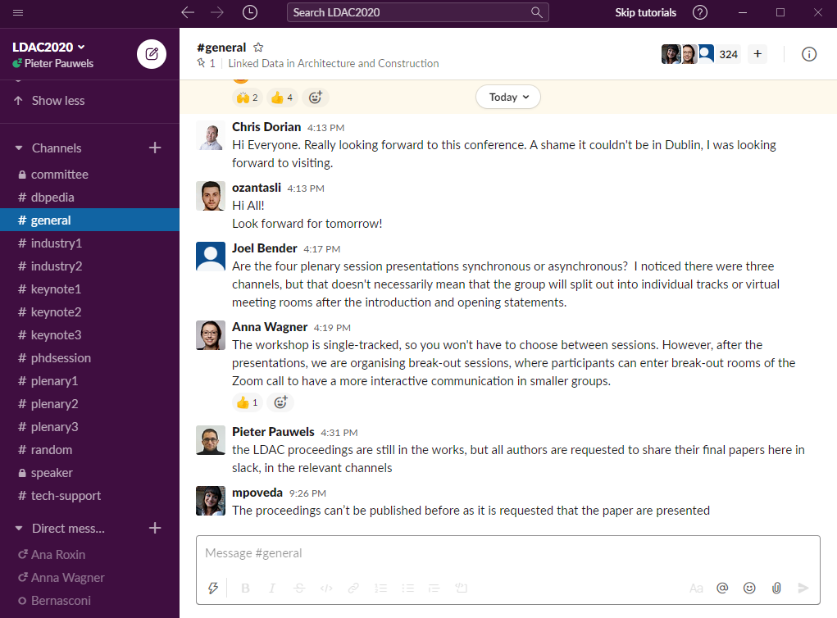
Slack
Coffee breaks
Private chats
Custom channels on request
Direct access to Zoom links per session
Access to papers, presentations, and presenters
Tech support
Requesting a breakout room

Slide 28
Questions?
Find help with one of the 350 people in Slack!
  #techsupport
  #general
  #speakers
  #random
Or mail to ldac2020@linkedbuildingdata.net

Slide 29
8th International Workshop on
Linked Data in Architecture and Construction
Hosted from Dublin, Ireland
Kris McGlinn, Markus Helfert, Declan O’Sullivan
Pieter Pauwels, María Poveda-Villalón, Jakob Beetz,
Ana Roxin, Mads Holten Rasmussen, Anna Wagner
http://linkedbuildingdata.net/ldac2020/

