Slide 1
Linked Data for Smart Homes
Comparing RDF and LPG
Alex Donkers MSc – PhD Candidate at Eindhoven University of Technology – a.j.a.donkers@tue.nl

Slide 2
Different domain knowledge
Many stakeholders
Siloed data
Building performance monitoring
Energy efficiency
Indoor environmental quality
Smart homes
IoT data integration
Activity recognition
Home automation
Health monitoring
Social media integration

Slide 3
We need to compare
RDF with other graph models

Slide 4
Graph models
- labels
Undirected graph
Simple graph
Multi-graph
Halve-edge graph
Labeled graph
Weighted graph
Property graph
Labeled property graph
Hypergraph
RDF
RDF*
Kitchen
Toilet

Slide 5
Graph models
no labels
directed edges
Undirected graph
Simple graph
Multi-graph
Halve-edge graph
Labeled graph
Weighted graph
Property graph
Labeled property graph
Hypergraph
RDF
RDF*

Slide 6
Graph models
multiple directed edges
Undirected graph
Simple graph
Multi-graph
Halve-edge graph
Labeled graph
Weighted graph
Property graph
Labeled property graph
Hypergraph
RDF
RDF*

Slide 7
Graph models
edge only connects one node
Undirected graph
Simple graph
Multi-graph
Halve-edge graph
Labeled graph
Weighted graph
Property graph
Labeled property graph
Hypergraph
RDF
RDF*

Slide 8
Graph models
labels
directed edges
Undirected graph
Simple graph
Multi-graph
Halve-edge graph
Labeled graph
Weighted graph
Property graph
Labeled property graph
Hypergraph
RDF
RDF*
Kitchen
Toilet

Slide 9
Graph models
labels
weighted, directed edges
Undirected graph
Simple graph
Multi-graph
Halve-edge graph
Labeled graph
Weighted graph
Property graph
Labeled property graph
Hypergraph
RDF
RDF*
Kitchen
Toilet
3

Slide 10
Graph models
directed edges
key-value pairs
Undirected graph
Simple graph
Multi-graph
Halve-edge graph
Labeled graph
Weighted graph
Property graph
Labeled property graph
Hypergraph
RDF
RDF*
Distance: 5m
Area: 12 m²
Area: 1 m²

Slide 11
Graph models
Labels
directed edges
key-value pairs
Undirected graph
Simple graph
Multi-graph
Halve-edge graph
Labeled graph
Weighted graph
Property graph
Labeled property graph
Hypergraph
RDF
RDF*
Kitchen
Toilet
Adjacent zone
Distance: 5m
Area: 12 m²
Area: 1 m²

Slide 12
Graph models
(s,p,o) structure
directed edges
unique resource identifiers
Undirected graph
Simple graph
Multi-graph
Halve-edge graph
Labeled graph
Weighted graph
Property graph
Labeled property graph
Hypergraph
RDF
RDF*
ex:
Kitchen
ex:
Toilet
ex:AdjacentZone

Slide 13
Graph models
edges can join multiple nodes
Garden
Undirected graph
Simple graph
Multi-graph
Halve-edge graph
Labeled graph
Weighted graph
Property graph
Labeled property graph
Hypergraph
RDF
RDF*
Adjacent zone
Kitchen
Toilet
Living room
Storage room
Adjacent zone

Slide 14
Graph models
Labels
directed edges
key-value pairs
Undirected graph
Simple graph
Multi-graph
Halve-edge graph
Labeled graph
Weighted graph
Property graph
Labeled property graph
Hypergraph
RDF
RDF*
Kitchen
Toilet
Adjacent zone
Distance: 5m
IRI: ex:AdjacentZone
Area: 12 m²
IRI: ex:Kitchen
Area: 1 m²
IRI: ex:Toilet

Slide 15
We need to compare
RDF with other graph models
with Labeled Property Graphs

Slide 16
Qualitative
Quantitative
Relationships
Ontologies
Query language
Attributes
Security
Interoperability
Other measures
Graph density
Nodes
Edges
Query execution times
Storage

Slide 17
Open Smart Home
Schneider, G.F. & Rasmussen, M.D. (2018)
http://doi.org/10.5281/zenodo.1244602
Consisting
Building information model
Sensor data
RDF Turtle format
- Using BOT, PRODUCT and PROPS ontologies

Slide 18
Data preparation
Original dataset
RDF
NSMNTX
LPG (NSMNTX)
N
k
v
N
Manual conversion
Custom LPG
k: v

Slide 19
Data preparation
Original dataset
RDF
NSMNTX
LPG (NSMNTX)
Kitchen
Manual conversion
Custom LPG

Slide 20
What are the differences?

Slide 21
The fundamental differences between the RDF and LPG models have influence on what and how we can model our data.

Slide 22
Attributes
LPG
LPG can hold attributes on nodes
RDF is more atomic, but also more expressive
Kitchen
Wall
Adjacent element
Type: NamedIndividual
Type2: Space
Type3: Kitchen
Label: “Kitchen”@en
Room number: “1”
Area: “15”
Name: “Kitchen of Alex”
Volume: “45”
Type: Element
Name: “Load bearing wall”
Color: “White”
Width: “300”
Length: “3000”

Slide 23
Attributes
RDF
“15”
“45”
“Load bearing wall”
:area
:Element
:volume
:Named Individual
:name
LPG can hold attributes on nodes
RDF is more atomic
:Space
:type
:type
:type
:Kitchen
:Wall
:adjacentElement
:type
:Kitchen
:color
“Kitchen”@en
“White”
:name
:roomNumber
:width
:length
“Kitchen of Alex”
“1”
“300”
“3000”

Slide 24
Attributes
LPG
LPG can hold attributes on edges and therefore qualify the relationship between two nodes.
Since RDF doesn’t have this construct, we need workarounds.
Sensor
Kitchen
Observation
Quantity: Temperature
Time: 2020-06-04T10:00:00
Value: 21
Unit: degree Celsius

Slide 25
Attributes
RDF
:Sensor
:Kitchen
:Observation1
LPG can hold attributes on edges and therefore qualify the relationship between two nodes.
Since RDF doesn’t have this construct, we need workarounds.
- Singleton property
:Temperature
:Quantity
:Observation1
:degree
Celsius
:Unit
:Time
:Value
“2020-06-04T10:00:00”
:Type
“21”
:Observation

Slide 26
Attributes
RDF
:Location
:Observation1
:Sensor
:Kitchen
:Measures
LPG can hold attributes on edges and therefore qualify the relationship between two nodes.
Since RDF doesn’t have this construct, we need workarounds.
Singleton property
Intermediate node
:Type
:Observation
:Value
:Quantity
:Unit
:Time
:degree
Celsius
:Temperature
“21”
“2020-06-04T10:00:00”

Slide 27
Attributes (weighted edges)
Weighted edges can unlock new possibilities for smart home cases, such as using network analysis algorithms.
“What is the shortest route from the Kitchen to the Living room?”
Kitchen
Dining
Adjacent zone
Distance: “3”
Adjacent zone
Adjacent zone
Distance: “1”
Distance: “2”
Hall
Living
Adjacent zone
Distance: “3”

Slide 28
Multiple instances of a relationship
LPG can identify multiple instances of a relationship.
In RDF, this is impossible, because this relationship is defined by a URI.
Observation
Sensor
Kitchen
Observation

Slide 29
Multiple instances of a relationship
:Observation1
LPG can identify multiple instances of a relationship.
In RDF, this is impossible, because this relationship is defined by a URI.
:Observes
:Location
:Sensor
:Kitchen
:Observation
:Type
:Observation2
:Observes
:Location

Slide 30
Multivalued properties
“Alex”
In RDF, multiple triples could be created with the same subject and predicate, but with a different object.
In LPG, it’s impossible to create multiple properties with the same ‘key’ but with different attributes.
:Restricted
:Kitchen
:Restricted
“Bob”
:Restricted
“Lisa”

Slide 31
Multivalued properties
:Kitchen
In RDF, multiple triples could be created with the same subject and predicate, but with a different object.
In LPG, it’s impossible to create multiple properties with the same ‘key’ but with different attributes.
Restricted: “Alex”
Restricted: “Bob”
Restricted: “Lisa”
:Kitchen
Restricted: [“Alex”, “Bob”, “Lisa”]

Slide 32
Different from LPGs, RDF stores typically support ontology modeling languages RDFS and OWL2 DL.

Slide 33
Different domain knowledge
Many stakeholders
Siloed data
Building performance monitoring
Energy efficiency
Indoor environmental quality
IoT data integration
Activity recognition
Home automation
Health monitoring
Social media integration

Slide 34
Ontologies
Shared
Formal
Explicit
RDF
has a rich ecosystem of creating, using and sharing ontologies
LPG
Using OWL/RDFS constructs in Neo4j is more cumbersome
They store domain knowledge
Facilitate interoperability
Enable deeper reasoning

Slide 35
RDF ♥ SPARQL
LPG ♥ Cypher & GQL & GSQL & PGQL &

Slide 36
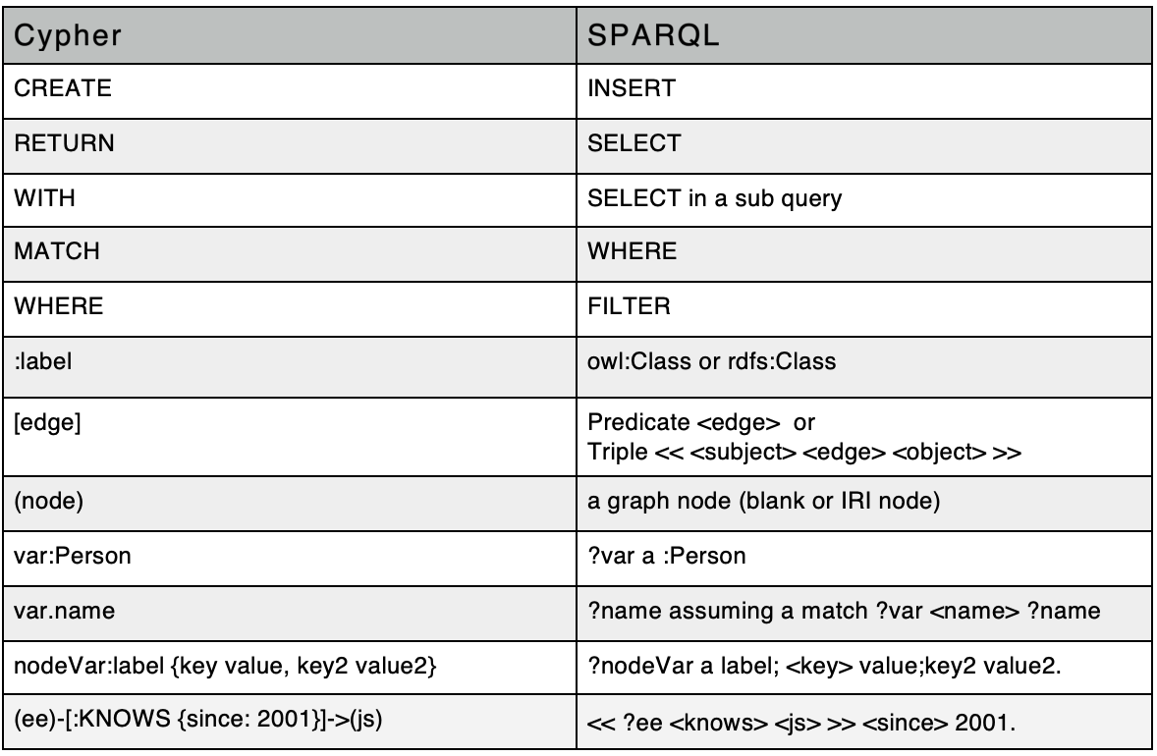
Are they really that different?
Constructs
Keen, A.: SPARQL and Cypher Cheat Sheet (2018)

Slide 37
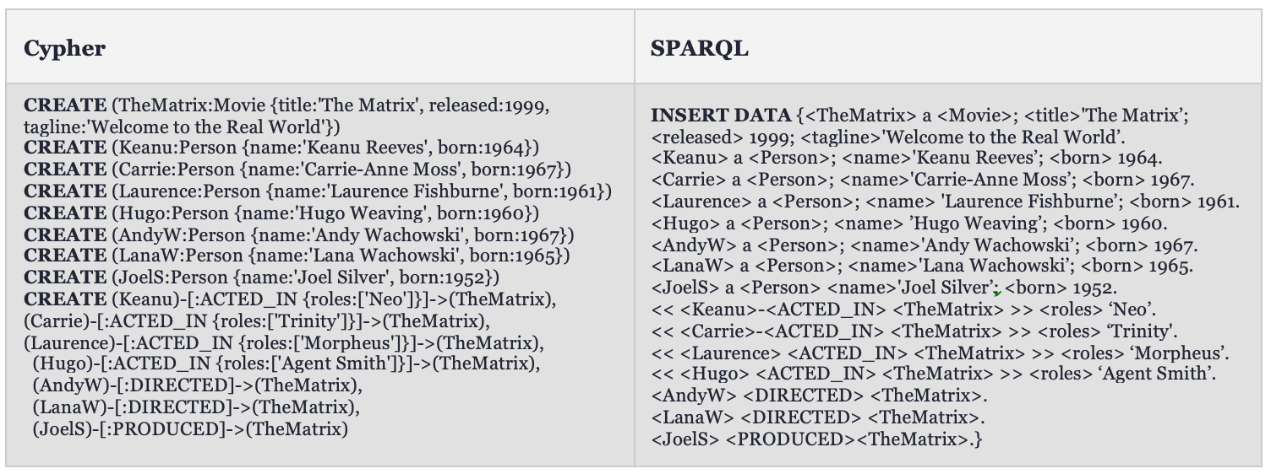
Are they really that different?
Constructs
Graph creation
Keen, A.: SPARQL and Cypher Cheat Sheet (2018)

Slide 38
Are they really that different?
Constructs
Graph creation
Object and pattern matching
Keen, A.: SPARQL and Cypher Cheat Sheet (2018)

Slide 39
Support
Security
Some other measures
Interoperability
Closed vs open world assumption
Index based vs navigational

Slide 40
What about the quantitative differences?

Slide 41
Complexity
Measure | RDF | LPG (NSMNTX) | Custom LPG
Nodes | 719 | 475 | 115
Edges | 1332 | 507 | 171
Graph Density | 0,0026 | 0,0023 | 0,013
File size | 106 kb |  | 29 kb
Measure | RDF | LPG (NSMNTX) | Custom LPG
Nodes | 27 | 16 | 2
Edges | 26 | 15 | 1
Graph Density | 0,037 | 0,063 | 0,5
File size | 7 kb |  | 2 kb
Kitchen

Slide 42
Queries (in Cypher)
Return all nodes
MATCH (n) RETURN n
Return all nodes and edges
2. MATCH (n)-[r]->(m) RETURN n,r,m
Return all nodes and edges of type ns0__AdjacentElement
3. MATCH (n)-[r:ns0__AdjacentElement]->(m) RETURN n,r,m
Return a list of walls with their length, width and name
4a.MATCH (n)-[:ns3__dimensionsLength]->()-[]->(l),
(n)-[:ns3__dimensionsWidth]->()-[]->(w),
(n)-[:ns3__identityDataName]->()-[]->(s)
RETURN n.uri, l.sch__value, w.sch__value, s.sch__value
4b.MATCH (n)-[]->(m)
RETURN m.uri, m.ns2__name,m.ns2__width,m.ns2__length
Kitchen

Slide 43
Query Execution Time
Query | LPG (NSMNTX) Before caching | LPG (NSMNTX) After caching | Custom LPG Before caching | Custom LPG After caching
1 | 23.8 ms | 2.6 ms | 13.8 ms | 1.3 ms
2 | 32.5 ms | 4.4 ms | 16.8 ms | 1.6 ms
3 | 27.8 ms | 1.8 ms | 18.0 ms | 1.6 ms
4 | 23.7 ms | 1.7 ms | 11.5 ms | 1.2 ms
Kitchen

Slide 44
Summary
Attributes on nodes
LPGs can attach attributes to nodes. RDF can store similar (or more expressive) information by creating new triples.
Attributes on edges
LPGs can attach attributes to edges. RDF needs complex workarounds to store the same information.
Relationships
RDF can have multivalued properties. LPG can have multiple instances of the same relationship.
Ontologies
RDF typically supports RDFS and OWL2. Using these languages in LPGs is more cumbersome.
Query language
RDF has a standardized query language. LPGs have different query languages based on the vendor.

Slide 45
Summary (2)
Complexity
LPGs are usually less atomic than RDF graphs, and therefore visually less complex.
Query execution time
In the queries we tested, the custom LPG outperformed the RDF import in query execution time.
File size
Due to the lower complexity, the file size of the LPGs is significantly lower.

Slide 46
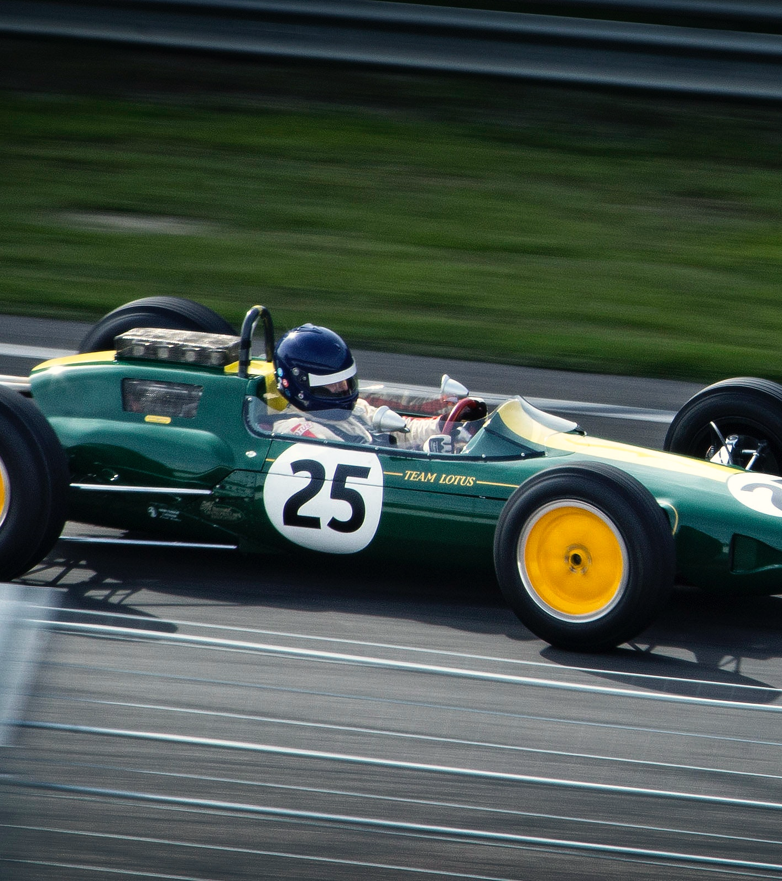
LPG
Fast
Good for large datasets, time-series data, path analysis, deep graph traversals
Good for single-stakeholder environments
RDF
International standard
Good for interoperability amongst multiple stakeholders
Good for domain knowledge sharing

Slide 47
Thank you.
Alex Donkers MSc – PhD Candidate at Eindhoven University of Technology – a.j.a.donkers@tue.nl

