Slide 1
Maryam Daneshfar, Timo Hartmann, Jochen Rabe
Technische Universität Berlin
A GIS-based Ontology for Representing the Surrounding Environment of Buildings to Support Building Renovation
LDAC 2020, Online
17th June 2020

Slide 2
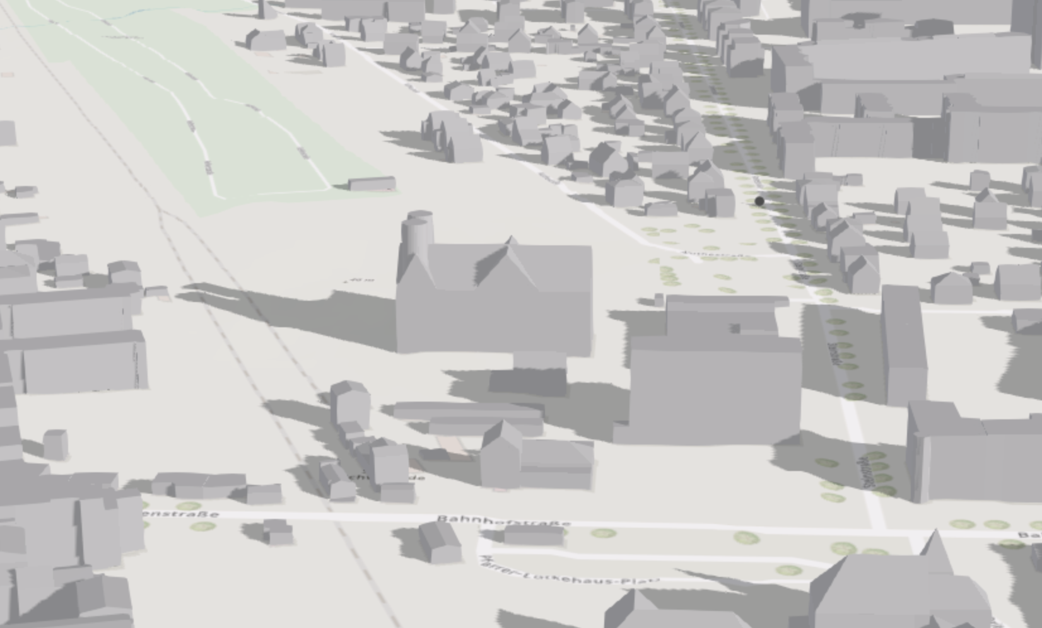
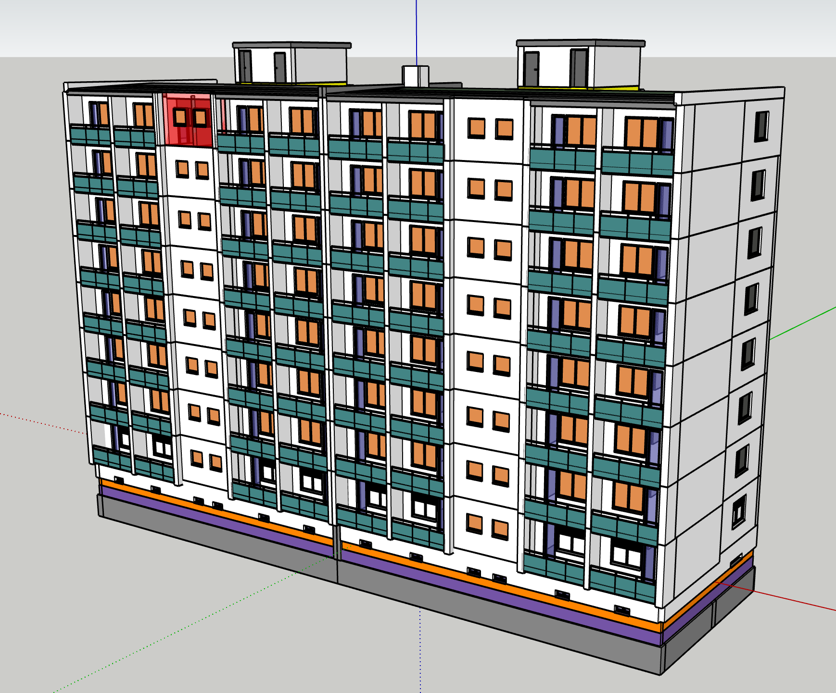
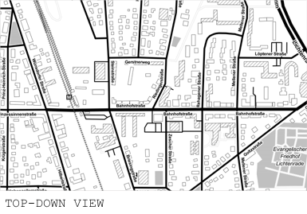

Building renovation is an inter-disciplinary task
Building renovation projects usually focus on data collection and analysis in individual building level
Surrounding and environment of the building affect its renovation process
The context where the building is located in is important
Introduction
Objectives
Theoretical framework
Method
Result
Discussion/Future work
Architecture, Construction
(BIM)
Geospatial domain
(GIS)
Notes:
BIM GIS integration
Effect of surrounding data in renovation process

Slide 3








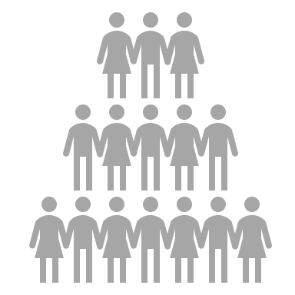


The objective is:
to conceptually define what kind of geospatial data are required for the renovation process
to represent the possibility of using data from geospatial domain in the renovation process
to get more attention toward geospatial domain in AEC and specifically in building renovation projects
To help in decision making to control cost and quality
Ontology is an approach for “an explicit specification of a conceptualization”
Gruber T-R (1995)
Introduction
Objectives
Theoretical framework
Method
Result
Discussion/Future work

Slide 4
Geospatial domain tries to model real-world in a simplified manner
Introduction
Objectives
Theoretical framework
Method
Result
Discussion/Future work
Real-world
Human’s perception
Expressing human’s perception in an explicit formal structure
Object view/Field view
Algorithms/Raster, Vector
Physical model
Computational model
Cognitive model
Logical model
Representational model
General concpets
High level
Low level
Specific concpets
Domain
Task
Urban ontology
Building renovation
Notes:
Example for objects, processes, relations, events

Slide 5
Introduction
Objectives
Theoretical framework
Method
Result
Discussion/Future work
Bona fide boundaries
Urban ontology
Objects
Relations
Processes
Events
Fiat boundaries
Fonseca F et al. (2000)
Notes:
Example for objects, processes, relations, events

Slide 6
France-Mensah et al. (2019) methodology
Introduction
Objectives
Theoretical framework
Method
Result
Discussion/Future work
Ontology specification
Knowledge acquisition
Conceptualization and implementation
Validation
Purpose
Scope
Intended end-users
Intended use
Literature review
Brainstorming
Interviewing experts
Defining use cases

Slide 7
Use case | Surrounding environment data | Source
Site planning | Building block, road, railway, vegetated area, single tres, parking lot, monument, societal data … | Göcer et al. 2016
Building energy modeling (BEM) | Weather data (*.epw weather file for energy modeling in EnergyPlus) | Crawley 1998 Huang 2011
Acoustic comfort analysis | Road, walkway, railway, railway station, airport location, playground and park, running water, pool, lake, noise map | Herranz-Pascual et al. 2017 Kang et al. 2016
Air quality comfort analysis | Road, building , CO₂ emission map | Leung 2015, Li et al. 2009
Thermal comfort analysis | Weather data, building, single tree, energy consumption behavior of the occupants, renewable energy sources | Aghniaey et al. 2018 Humphreys et al. 2000
Lighting comfort analysis | Building, tree | Jung 2018 [24]
Introduction
Objectives
Theoretical framework
Method
Result
Discussion/Future work
Notes:
This is an initial list of the use
Description of site planning
Description of BEM

Slide 8
Examples of use cases
Site planning
Considerations for selection of method for 3D laser scanning or thermal scanning of the building
High dense built area
Single trees
Building energy modelling
Weather data
Urban climate
Introduction
Objectives
Theoretical framework
Method
Result
Discussion/Future work

Slide 9
France-Mensah et al. (2019) methodology
Ontology specification
Knowledge acquisition
Conceptualization and implementation
Validation
Introduction
Objectives
Theoretical framework
Method
Result
Discussion/Future work
Object
Built area
Process
Vegetation
Energy network
Environment-related
Traffic network
Energy-related
Water
Population-related
The OWL of the ontology is available online:
https://depositonce.tu-berlin.de/handle/11303/11235

Slide 10
Building
hasBuilding
Building block
buildingBlockArea
double
Introduction
Objectives
Theoretical framework
Method
Result
Discussion/Future work
numberOfFloor
facadeMaterial
buildingHeight
Parking lot
Parking space
double
int
string
buildingArea
containsBUildingBlcok
double
parlingArea
double
Landuse type
hasLanduseType
Parcel
containsPrking
Parking
string
landUseTye
hasParcel
Object
Built area
containsMonument
Monument
districtArea
double
District
districtName
hasConstraint
Vegetation
Park
string
Construction regulation
Single tree
treeHeight
parkArea
parkName
double
double
treeCrownSize
string
string
treeSpecies
double
Notes:
Description of some data and their attributes

Slide 11
Object
Introduction
Objectives
Theoretical framework
Method
Result
Discussion/Future work
Energy network
hasEnergyType
EnergyType
double
riverWidth
riverName
River
Water
string
string
energyType
string
pondName
Pond
Lake
lakeArea
double
double
pondArea
string
roadType
RoadType
lakeName
string
string
railwayType
RailwayType
hasRoadType
Traffic network
double
roadWidth
Road
hasRailwayType
railwayWidth
Railway
double
double
walkwayWidth
Walkway
string
railwayStationName
Railway station
string
airportName
Airport

Slide 12
Energy type
energyType
string
double
Population-related
hasEnergyConsumptionVal
Energy consumption value
energyConVal
Introduction
Objectives
Theoretical framework
Method
Result
Discussion/Future work
hasEnergyType
Process
Energy consumption
Renewable energy potential
Environment-related
Geothermal potential
Wind power potential
Energy-related
hasDepth
Depth
Photovoltaics
depth
hasWindPowerElectricityFeed
double
hasSolarPotential
ElectricityFeed
Solar energy potential
hasWithdrawlPerformance
solarPotentialElectricityFeedVal
Solar potential electricity feed
Biomass potential
Wind power electriciy feed
double
Solar thermal
hasSolarPotentialHeatElectricityFeed
Withdrawl performace value
double
windPowerElectricityFeedVal
Solar potential heat electricity feed
windPowerElectricityFeedVal
double
hasElectricityGenerationPotential
solarPotentialHeatElectricityFeedVal
double
electricityGenVal
double
Electricity generation potential
Notes:
Description of some processes and their attributes

Slide 13
Object
District
Introduction
Objectives
Theoretical framework
Method
Result
Discussion/Future work
Building block
hasBuilkding
Building
Population age
hasPopulationAgeRange
Population age range
hasProcess
Energy-related
Population-related
hasPopulationAgeRangeVal
Process
Population density
hasPopulationDensityVal
Population density value
Population age range value
Environment-related
Population education level
CO2 emission
hasCo2EmissionVal
CO2 value
co2Val
double
hasEducationLevel
populationAgeRangeVal
populationDensityVal
Noise level
hasNoiseLevelVal
Noise level value
noiseLevelVal
double
Education level
double
Weather
isLinkedTo
Weather file
fileContains
Weather data
double
educationLevelVal
string
File format
The file format which is accepted by the energy modeller e.g *.epw file format
hasFormatConstraint
double
windDirection
double
humidity
double
windSpeed
int
temperature

Slide 14
Introduction
Objectives
Theoretical framework
Method
Result
Discussion/Future work
Implications for practice:
  this ontology can be used as a tool for decision makers in the renovation process. It helps energy experts, architect and planners to understand the urban context and get more accurate results and less cost
Implications for research:
  this can be used as a basis for data integration of BIM and GIS for renovation purposes
  Investigating how developing this ontology and integrating it with other ontologies can contribute to the linked data

Slide 15
Work in Progress
Introduction
Objectives
Theoretical framework
Method
Result
Discussion/Future work
Objective was to conceptually define what kind of geospatial data are required for the renovation workflow
  This part has been done based on use case definition, brainstorming, literature review and incorporating experts
  Future task: involving other experts, defining new use cases
Objective was to support planners, decision-makers, and experts involved in the renovation process
  To validate and check the competency of the ontology
  Presenting a proof of concept

Slide 16
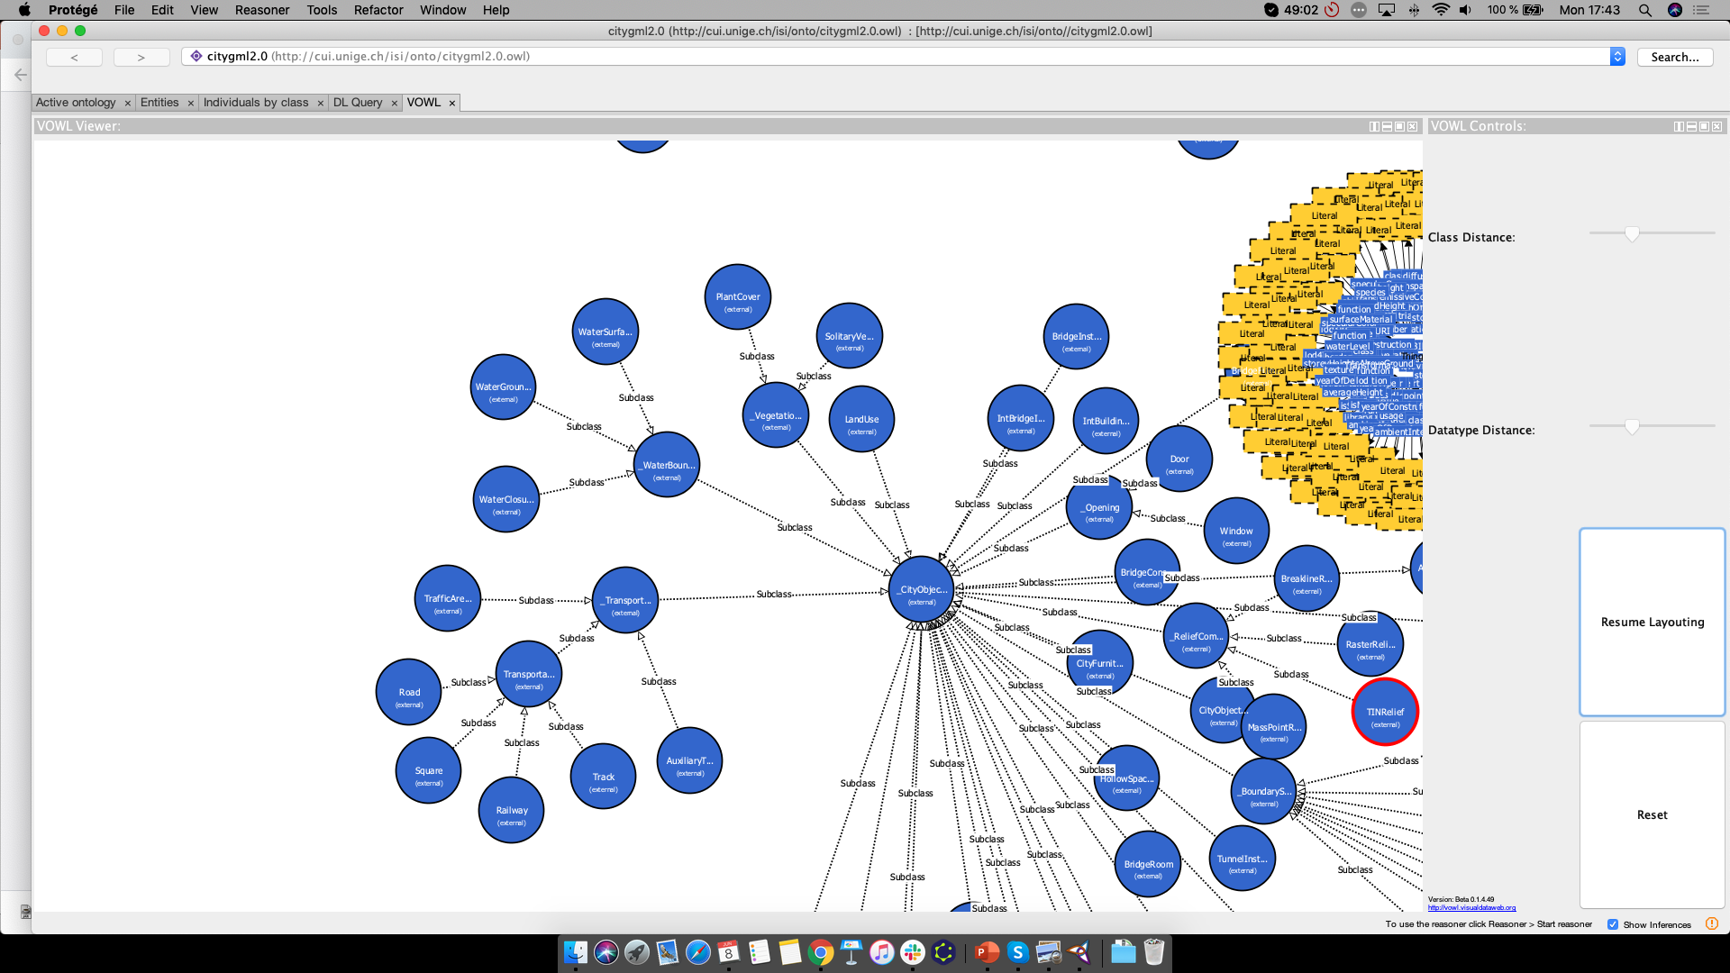
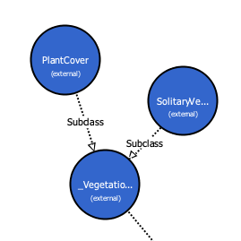
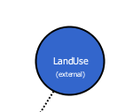
Future Work
      Existing ontologies
Introduction
Objectives
Theoretical framework
Method
Result
Discussion/Future work
Ontology for Managing Geometry
(OMG)
Building Topology Ontology
(BOT)
CityObject
CityGML

Slide 17
Thanks for you attention
This research project is funded under the European Union’s program H2020-NMBP- EEB-2018, under Grant Agreement no 820553.

Slide 18
Key references
Gruber T-R (1995) Toward principles for the design of ontologies used for knowledge sharing? International Journal of Human-Computer Studies, 43(5-6), 907–928.
Fonseca F, Egenhofer M, Davis C, Borges K A (2000) Ontologies and knowledge sharing in urban GIS. Computers, Environment and Urban Systems, 24(3), 251–272.
France-Mensah, J., & O’Brien, W. J. (2019). A shared ontology for integrated highway planning. Advanced Engineering Informatics, 41, 100929.

