Slide 1
Bjørnafjorden Open Live Centre (BOLC) and the V440 ontology

Slide 2
Agenda
Presentation of the project (sponsor) and the innovation process (incl 3 min video)
Ingar Skogli, Statens Vegvesen
What’s in the Handbook? Why Digitize?
Lars Wikström, Triona
The ontology. Development and Deployment
Lars Wikström, Triona
Implementation in Software 1
Hans Kristian Grani, Areo
Implementation in Software 2
Espen Skogsrud, BuildingPoint Scandinavia

Slide 3
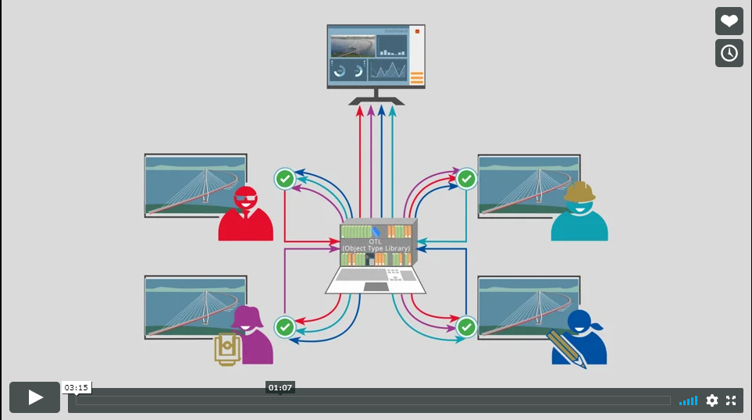

Slide 4
Norwegian Road Authority responsibility
The Norwegian Public Roads Administration has sector responsibility for following up national tasks for the entire road transport system
The Norwegian Public Roads Administration is responsible for the National Road Database and the Road Traffic Centers, and will work to standardize road, traffic and transport data.
Foto: Bernt Nilsen

Slide 5
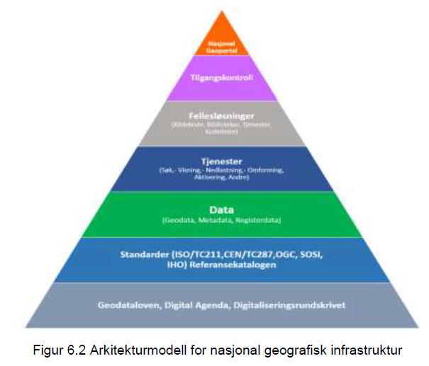
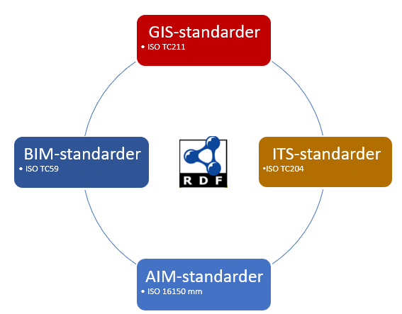
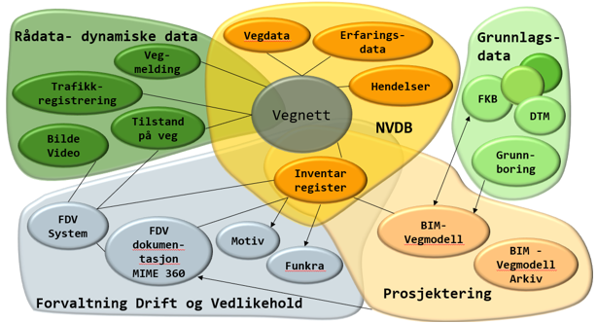
Standardization framework in Norwegian Road Authority
Road lifecycle
Planning
Engineering
Building
Operation and maintenance
1
Standardization should contribute to streamlining data flows between stakeholders and phases (includes all road owners)
The work will be part of national geospatial infrastructure
Includes standardization across domains
Includes standardization across systems
Standardization should contribute to an open market and a level playing field
3
2
4

Slide 6
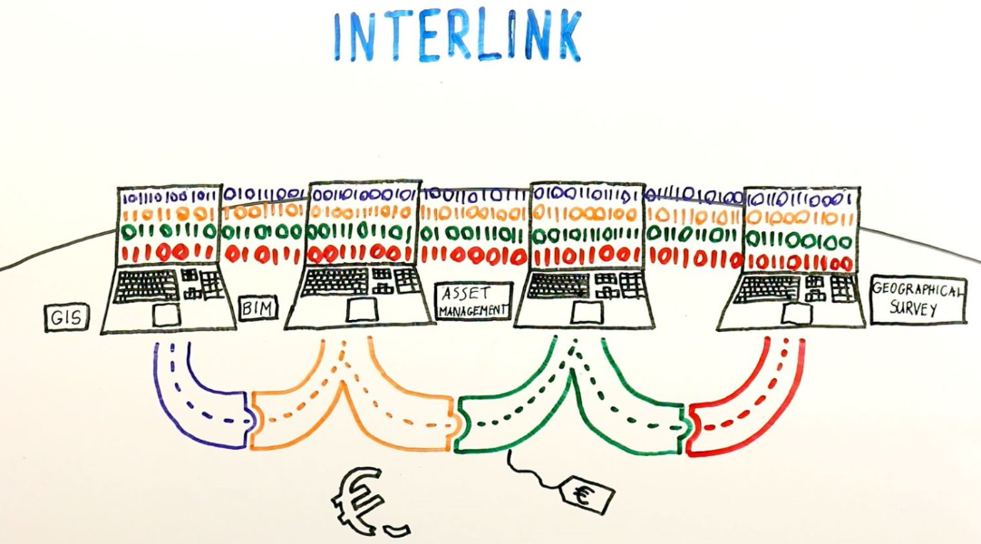
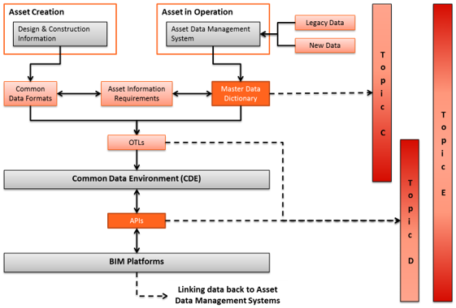
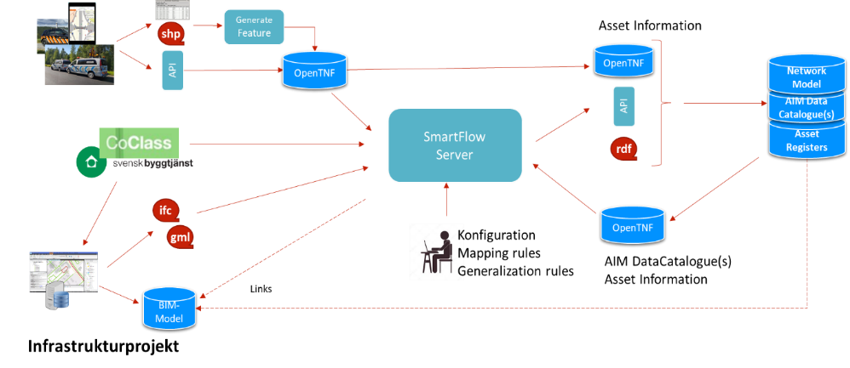
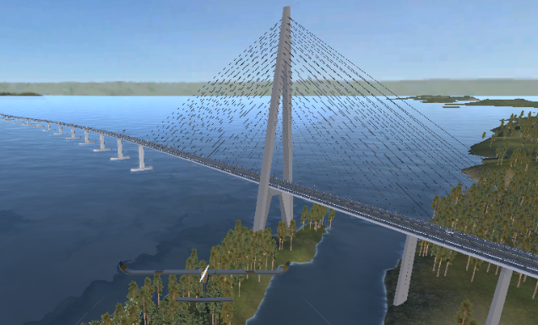
Norwegian Road Authority – standardization activities SW/LD
CEDR Interlink 2015-2018 CEDR call 2018 InfraSweden2030
Bjørnafjord project
We are following a pilot project to assess what synergies this may give towards the agency's standardization work
Established technical infrastructure for storage / management of ontologies and sparql endpoint

Slide 7
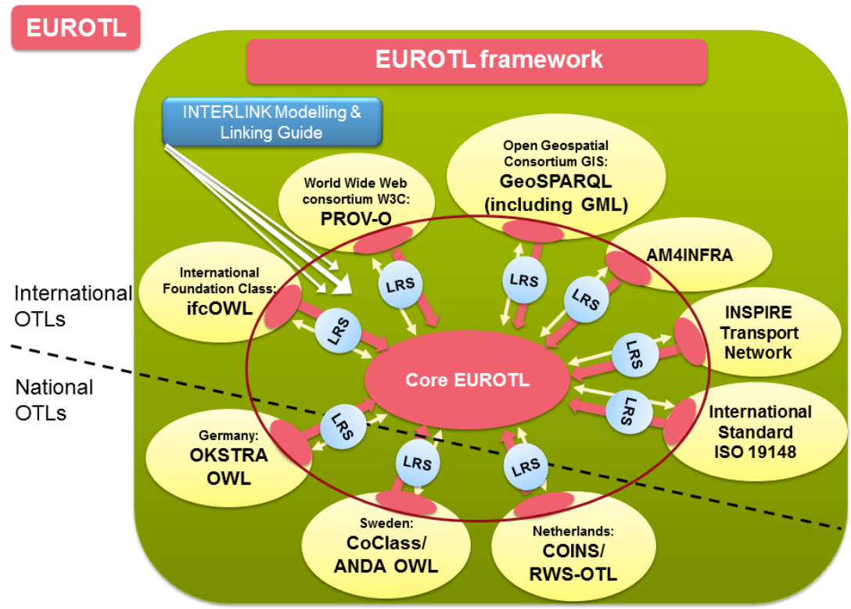
How do the project contribute to standardization framework in Norwegian Road Authority
The project has shown good results
Covering engineering and building phase
The project show that more work need to be done.
Cover national geospatial infrastrucure, operation and maintenance phase

Slide 8
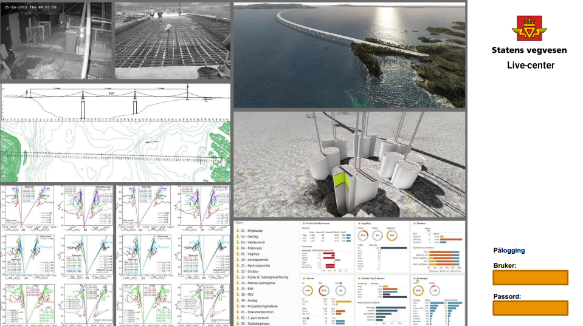
Functionality examples for Open Live Centre (BOLC):
Extract and present data from the BIM-server
Harvest and publish data from different sources, like:
Quantities
Collisions and constructability
Cost / Compensations
Status / Progress
Logistics
RFID-sensors/ QR-code readings
HR-data
Environmental data
Surveillance camera
Visualisation / Animation
Etc.

Slide 9
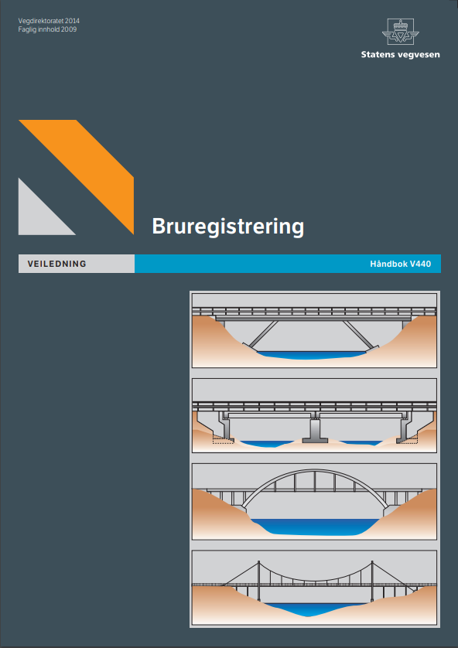
Provides guidance for registration and condition monitoring of bridges;
Contains registration process descriptions and rules for bridge document management;
Provides a comprehensive list of definitions of bridge type, bridge part and bridge element classification.

Slide 10
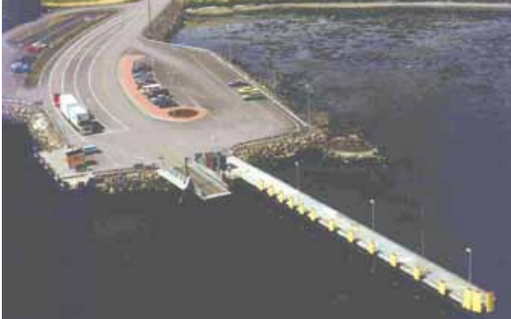
Examples of bridge classification:
Bridge Categories:
Code Description
1 Road bridge
2 Bridge embedded in the road superstructure
3 Pedestrian bridge
4 Ferry landing
6 Tunnel
7 Supportive structures
8 Railroad bridge
9 Other structures

Slide 11
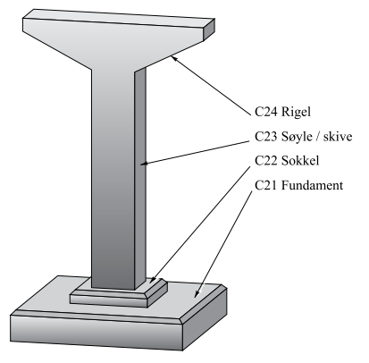
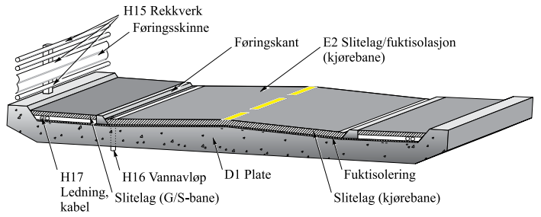
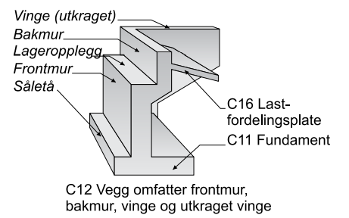
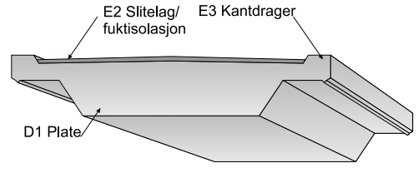
Examples of bridge classification:
Detailed Bridge Element Codes:

Slide 12
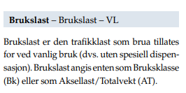
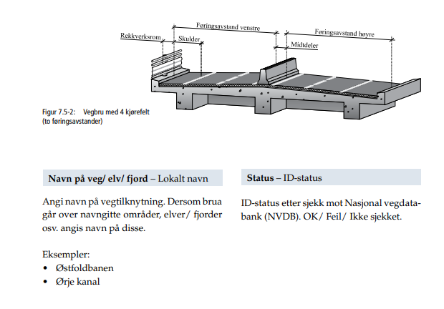
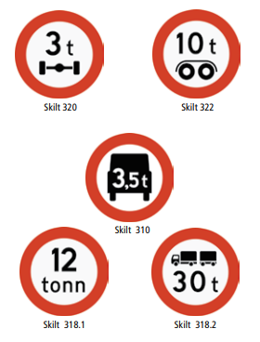
Properties:

Slide 13
Why make an ontology for the Handbook V440?
Make the structure of V440 explicit and machine readable
Using RDF, RDFS, OWL as a FORM FOR REPRESENTATION, keeping the essence intact!
Directly referenceable from other standards/formats such as IFC & *GML
Through the use of URI:s
”Mappable” to other structures
Through ”Linking Rule Sets”, or ”Alignment ontologies”
Available through standard Web API:s
http GET, SPARQL endpoint
Exchange format ”for free” for both schema and data

Slide 14
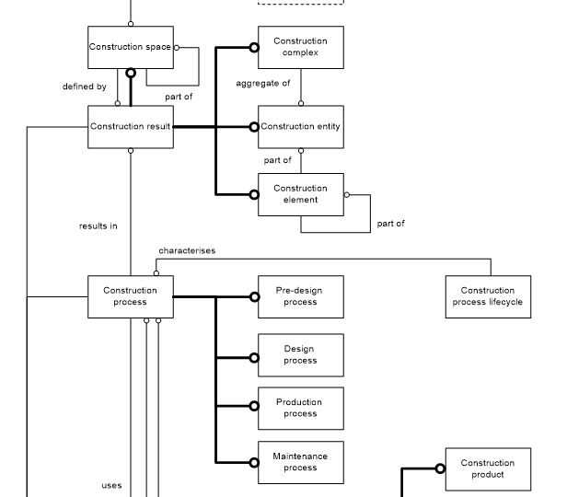
Inspiration from ISO 12006-2 Building construction — Organization of information about construction works
Part 2: Framework for classification
Construction complex
aggregate of construction entities serving at least one user activity or function
Construction entity
an independent unit of the built environment with a characteristic spatial structure, serving at least one user activity or function
Construction Entity part
constituent of a construction entity
Construction element
constituent of a construction entity with a characteristic technical function, form or position
Construction process
process which uses construction resources to achieve construction results

Slide 15
Use/test of CEN/TC442 Semantic Modelling and Linking Standard

Slide 16
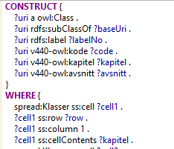
The process:
Understand
V440
Define principles
Verify principles with domain experts
Verification
Validation
Generate V440 ontology using SPARQL/SPIN
Define Excel structure
Bulk input from domain experts
Convert excel to rdf (generic spreadsheet structure)

Slide 17
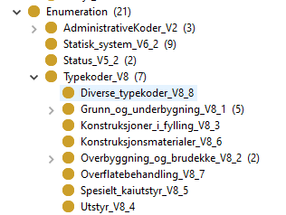
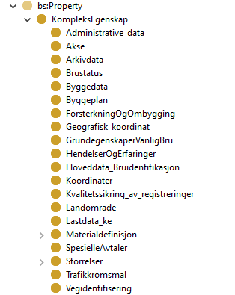
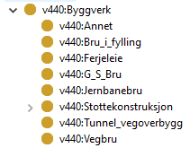
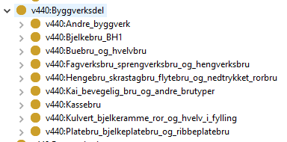
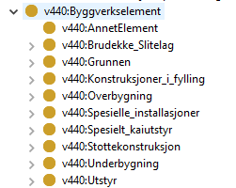
Construction entity
Properties
Ontology
hasPart
hasPart
Construction entity part
Construction element

Slide 18
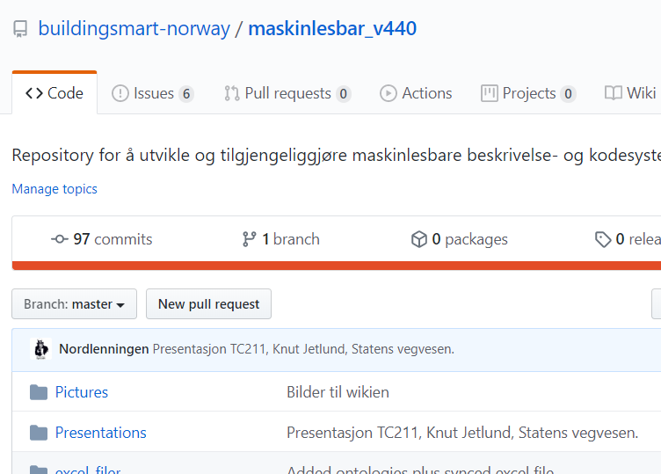
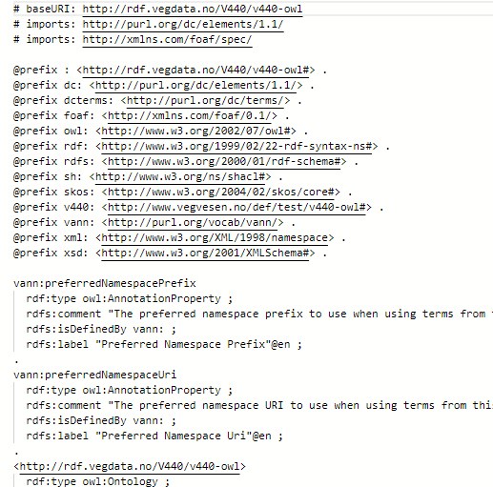
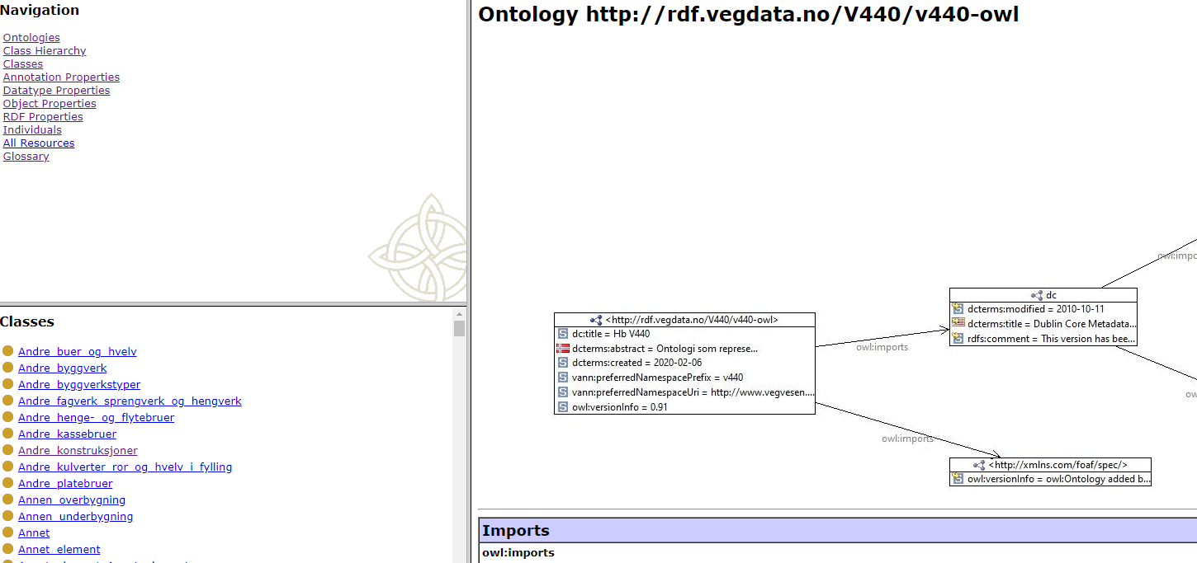
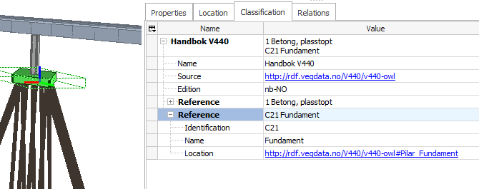
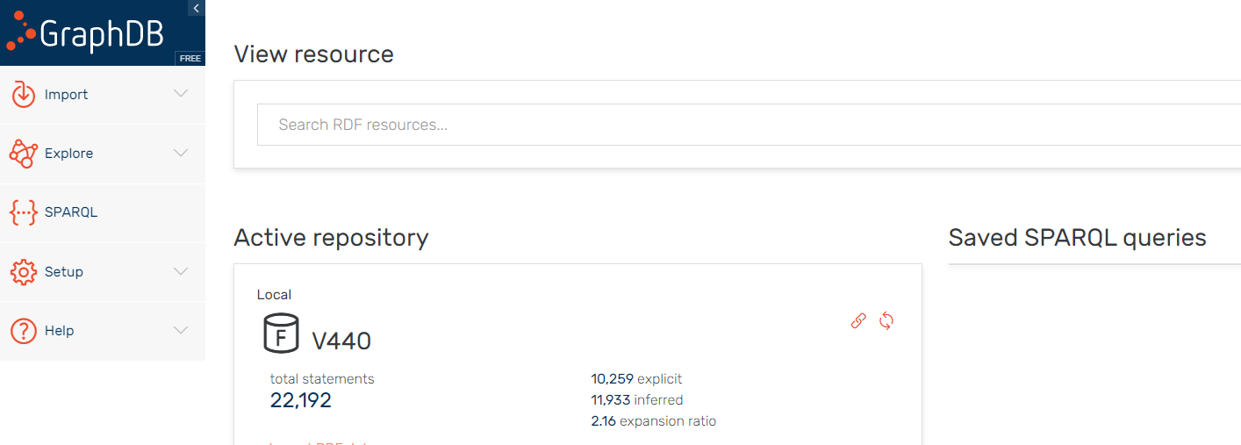
Interoperate:
Set up GitHub
Make ontologies available online:
http://rdf.vegdata.no/V440/v440-owl
http://rdf.vegdata.no/V440/v440-brudata-owl
SPARQL endpoint
Example IFC + classification
Invite software companies
Use ontology in software applications
Demonstrations (AREO, BuildingPoint Scandinavia)

Slide 19
DEMO 1: AREO

Slide 20
DEMO 2: BuildingPoint Scandinavia

