Slide 2
Multiple paths to the destination: The SAREF journey
Laura Daniele, TNO
Keynote @LDAC2020 - 8th Linked Data in Architecture and Construction Workshop
18 June 2020

Slide 3
Introduction

Slide 4


About me
MSc in Electronic Engineering (University of Cagliari, Italy) and PhD in Computer Science (University of Twente, NL)
Senior Scientist at TNO, Data Science department, Unit ICT
Data Science department combines expertise in AI and data analytics with expertise in semantics, standards, interoperability architectures and data governance
Leading semantic interoperability research and standardization activities in IoT at TNO
Expert in ETSI SmartM2M TC
Co-leader of the semantic interoperability group in WG3 of AIOTI together with Martin Bauer (NEC)
Leading scientist in H2020 Interconnect large scale pilot for smart and interoperable homes, buildings and grids
Supervision of PhDs and MScs
laura.daniele@tno.nl
https://nl.linkedin.com/in/lauradaniele

Slide 5
About TNO (I)
Largest Dutch independent research organization. Intermediary between basic research organisations and industry
Based on its expertise and research in technological, policy, business and social innovation, TNO connects people and knowledge to create innovations that boost the competitive strength of industry and the well-being of society in a sustainable way
Staff of over 3200 professionals and an annual turnover of 565 million Euros. Research to achieve impact on different themes addressing Societal Challenges. Organized in units (see next slide)
By translating scientific knowledge into practical applications, TNO contributes to the innovation capacity of businesses and government
TNO is involved in many international projects (about 30% of the market turnover), including EU-funded collaborations (Technology Platforms, Horizon 2020, KIC’s)

Slide 6










About TNO (II)
+
+
Traffic and transport
Buildings, infrastruc-ture and maritime
Organized in 9 Units
Buildings, Infrastructure & Maritime
Circular Economy
& Environment
Defense, Safety & Security
Energy Transition
Healthy Living
Industry
Information & Communication Technology
Strategic Analysis
& Policy
Traffic & Transport
+
+
Strategy analysis and policy
Circular economy and environment
Information and communication technology
+
Defense, safety and security
+
Industry
Energy transition
+
Healthy living
+
+

Slide 7
What are we going to talk about?

Slide 8
Abstract
Retitled to: “Multiple paths to the destination: the SAREF journey”
Thursday 18 June—Workshop (all times are given in Central European Summer Time) and Eastern Summer Time USA)
It was actually 2013!
09:30–10:30 CEST, 03:30–04:30: keynote by Laura Daniele
The Smart appliances REference Ontology (SAREF), its development and its application
In this talk I will take you into a journey that started in 2014, when the European Commission launched the first initiative to build a common ontology in close collaboration with the smart appliances industry, which resulted into the creation of the Smart Appliances REFerence ontology (SAREF). Six years later, SAREF is a series of technical specifications published by the European Telecommunication Standardization institute (ETSI), consisting of a modular framework that comprises a generic core ontology for loT and 10 domain-specific extensions, including SAREF for Energy, Buildings and Cities, which are of particular interest for the LDAC community. The SAREF framework is maintained and evolved by experts from several European organizations that successfully collaborate with each other and can count on the continuous support of ETSI and the European Commission. One of the latest supported initiatives is the development of an open portal for the SAREF community and industry stakeholders, so that they can contribute directly to the SAREF evolution. On the practical side, the recently started H2020 interconnect Large Scale Pilot uses SAREF and its extensions as basis to enable interoperable solutions connecting smart homes, buildings and grids in various pilots located in seven different countries in Europe. During the talk I will share with you the lessons learned this journey and the challenges ahead, addressing questions and curiosities, like what makes SAREF a successful story, how to keep an ontology relevant to the industry and its community of users, how to consistently maintain and evolve extensions in various domains, but also more specific topics for the LDAC community, such as how to model buildings and different domains related to buildings, how to link SAREF to other domains, and what are the challenges when concretely using the ontology to develop large scale real applications, especially when going across-domain like the interconnect project aims to do when combining the different domains of smart homes, buildings and grids
So we are now seven years
later …
No longer Smart Appliances REFerence ontology, but Smart Applications REFerence ontology (still SAREF!)

Slide 9
And the
journey begins …

Slide 10
Background
2013
In 2013 the European Commission launched a standardization initiative (SMART 2013/0077 study) in collaboration with ETSI TC SmartM2M
Goal of the study was to create a commonly agreed language (interoperable concepts) for the smart appliances domain
Study conducted by TNO from January 2014 to March 2015
www.sites.google.com/site/smartappliancesproject

Slide 11
Motivation (I)
2013
Societal challenge: Achieve higher energy efficiency
The household sector represented around 27% of the entire consumption in the EU in 2010 and has been above 25% in the last 20 years*
Energy using and producing Products (EupPs) that are inherently present in the buildings’ ecosystem are the main culprits
Home appliances are energy using and producing Products (EupPs)
designed to accomplish household functions, like cleaning or cooking
Major appliances (White goods)
E.g., Refrigerators, stoves, washing machines
Small appliances (Brown goods)
E.g., Toasters, coffee makers, air conditioners, light bulbs
Consumer electronics (Shiny goods)
E.g., PCs, TVs, mobile phones, cameras
* Mertens, R., et al.: Manual for Statistics on Energy Consumption in Households. Publications Office of the European Union, Luxembourg (2013)

Slide 12
Motivation (II)
2013
More and more home appliances are smart appliances
Highly intelligent and networked devices
Complete energy consuming, producing and managing systems
Need for open and standardized interfaces among networked devices (often from different vendors) constituting these systems
Need to abstract from specific details of individual standards and create an abstraction layer based on a commonly agreed semantics
Need for high level model - a reference ontology - that defines recurring concepts in the smart appliances domain without having to know specifics of the various standards
The Smart Appliances REFerence ontology (SAREF) as
“interoperability language”

Slide 13
But before we get into the journey …
What is SAREF?
There are several ways I can show you what is SAREF and how it looks like …

Slide 14
What is SAREF?

Slide 15

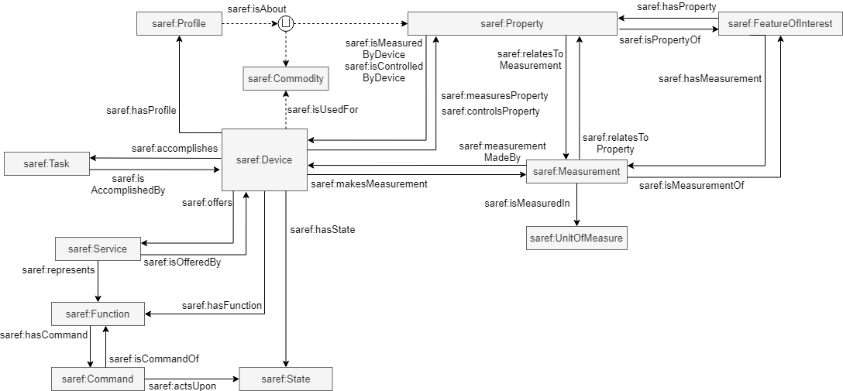
…SAREF is an ontology
Smart Applications REFerence ontology (SAREF)
https://saref.etsi.org/
Source: ETSI TS 103 264 V3.1.1

Slide 16
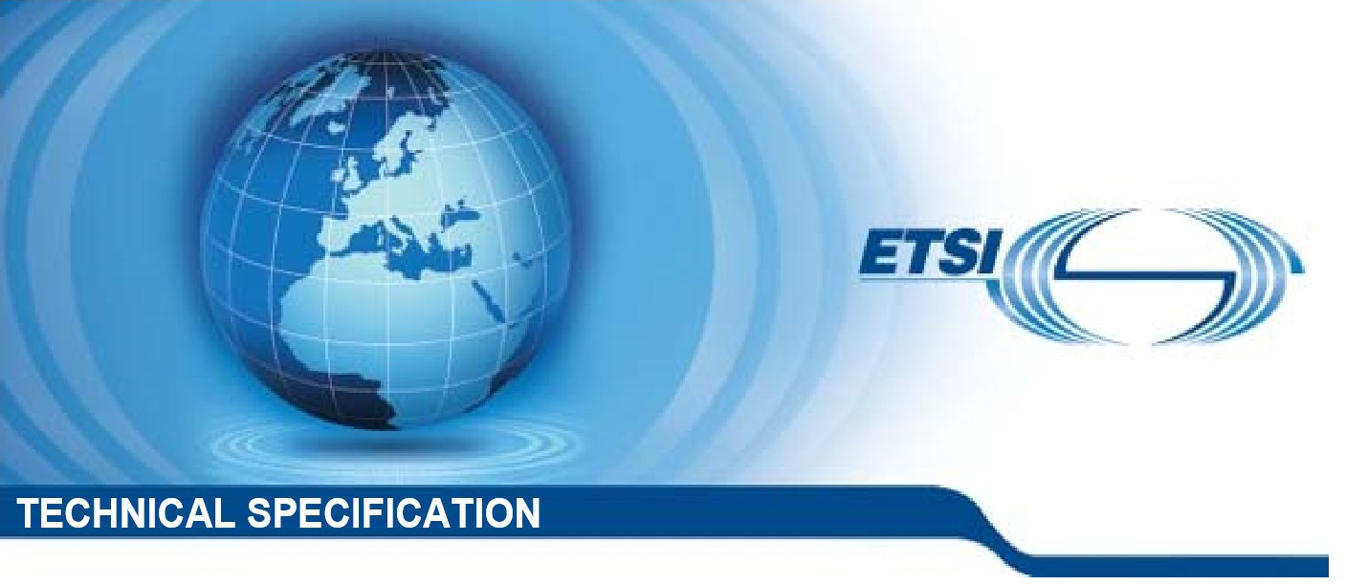
… SAREF is a (series of)
Technical Specification (s)
ETSI TS 103 264 V3.1.1 (2020–02)
SAREF version 3 Technical Specification (February 2020): TS 103 264 V3.1.1
Previous versions
SAREF version 2 Technical Specification (March 2017): TS 103 264 V2.1.1
SAREF version 1 Technical Specification (November 2015): TS 103 264 V1.1.1
SmartM2M;
Smart Applications;
Reference Ontology and oneM2M Mapping

Slide 17
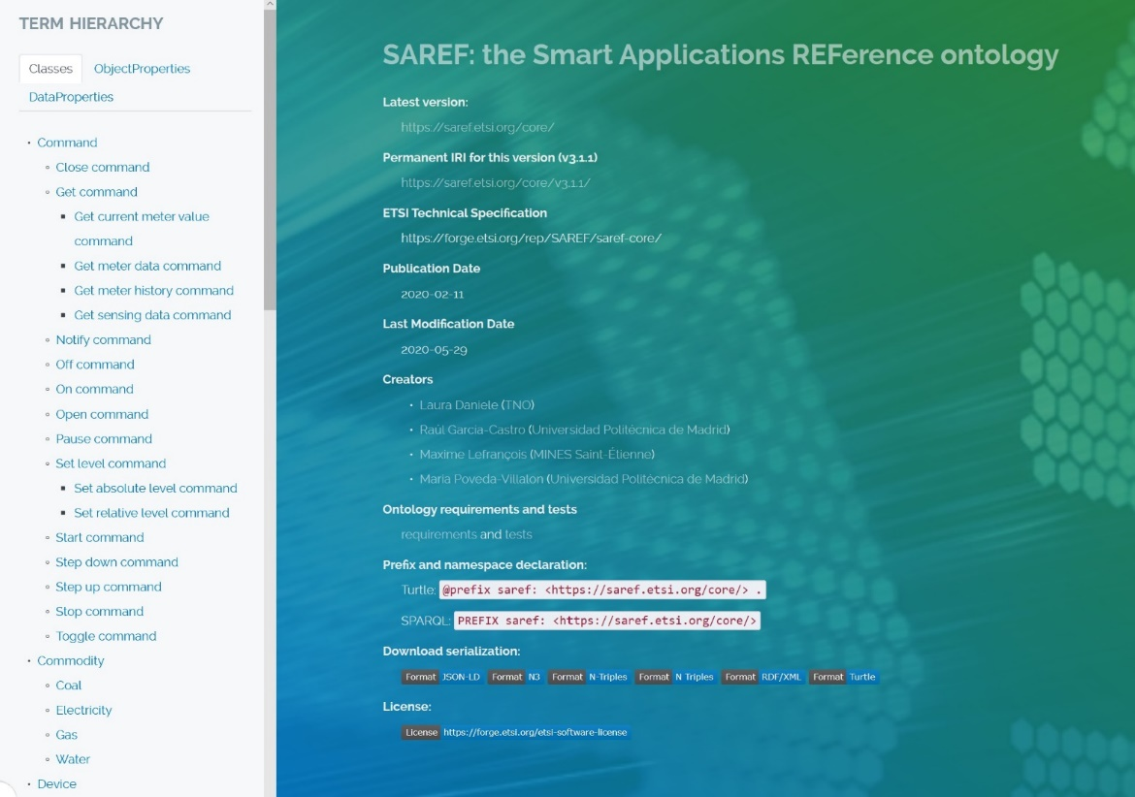
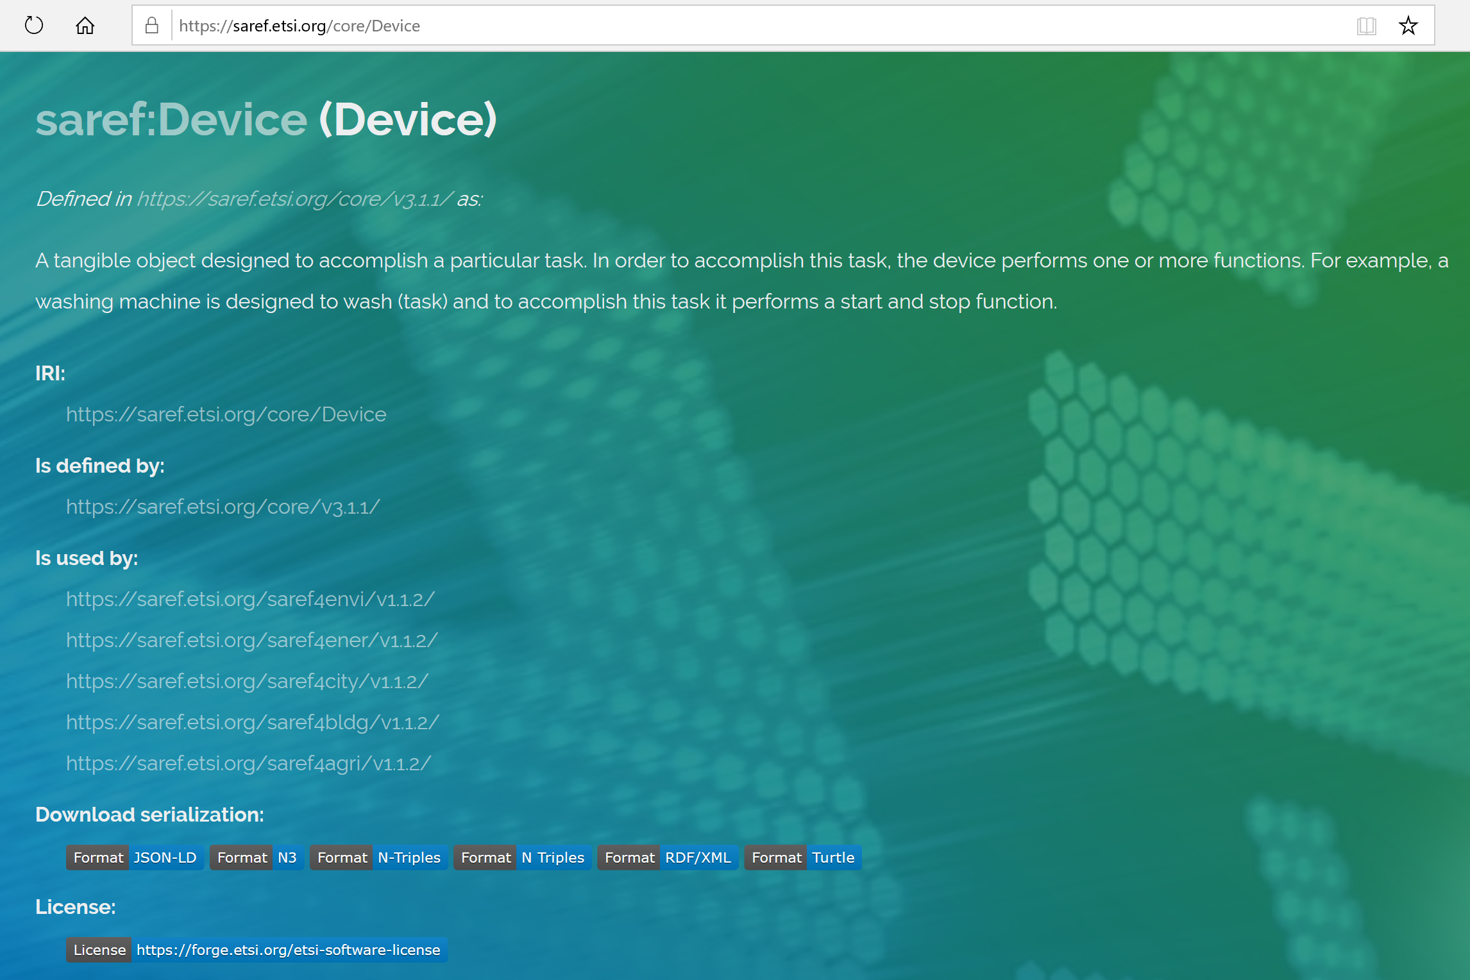
… SAREF is also a portal with a very pretty
and user-friendly documentation
https://saref.etsi.org/core/
https://saref.etsi.org/core/Device

Slide 18
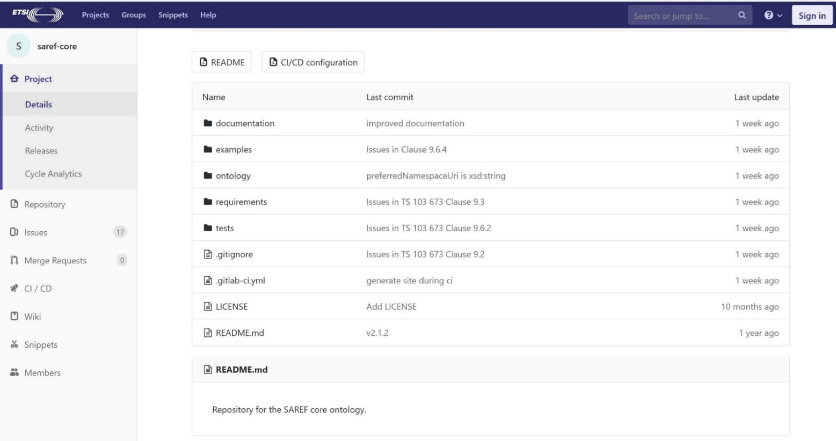
… SAREF is a repository for developers
https://forge.etsi.org/rep/SAREF
Main contact SAREF portal:
Maxime Lefrançois, IMT - MINES Saint-Étienne, maxime.lefrancois@emse.fr (STF 578 leader)

Slide 19
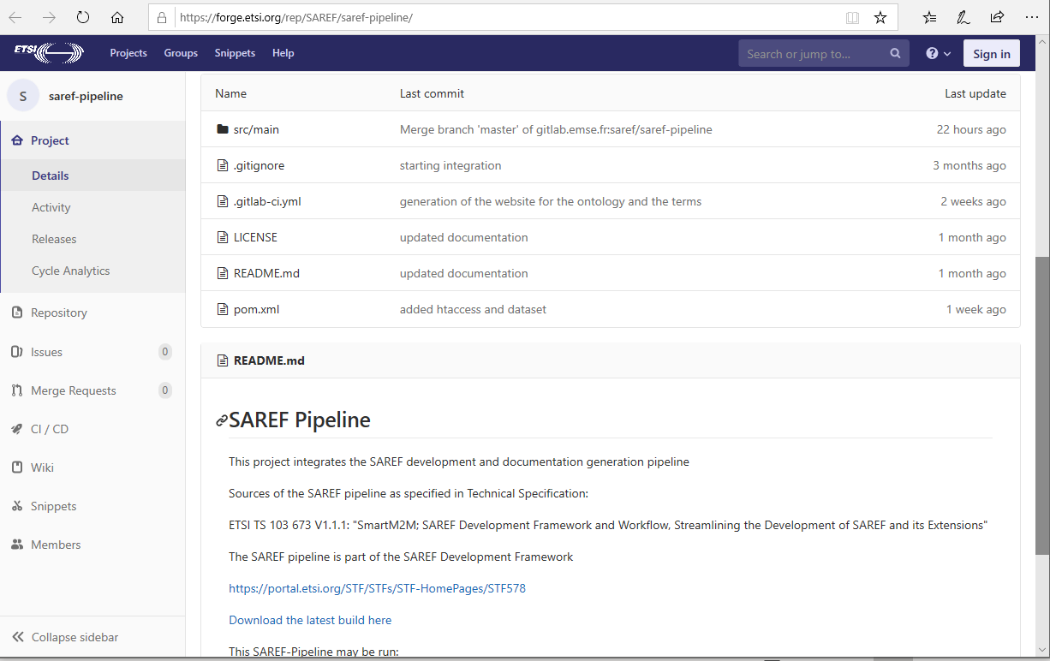
… with a pipeline and automated workflow
for checking consistency & correctness and creating documentation …
https://forge.etsi.org/rep/SAREF/saref-pipeline
Main contact SAREF portal
Maxime Lefrançois, IMT - MINES Saint-Étienne, maxime.lefrancois@emse.fr (STF 578 leader)

Slide 20
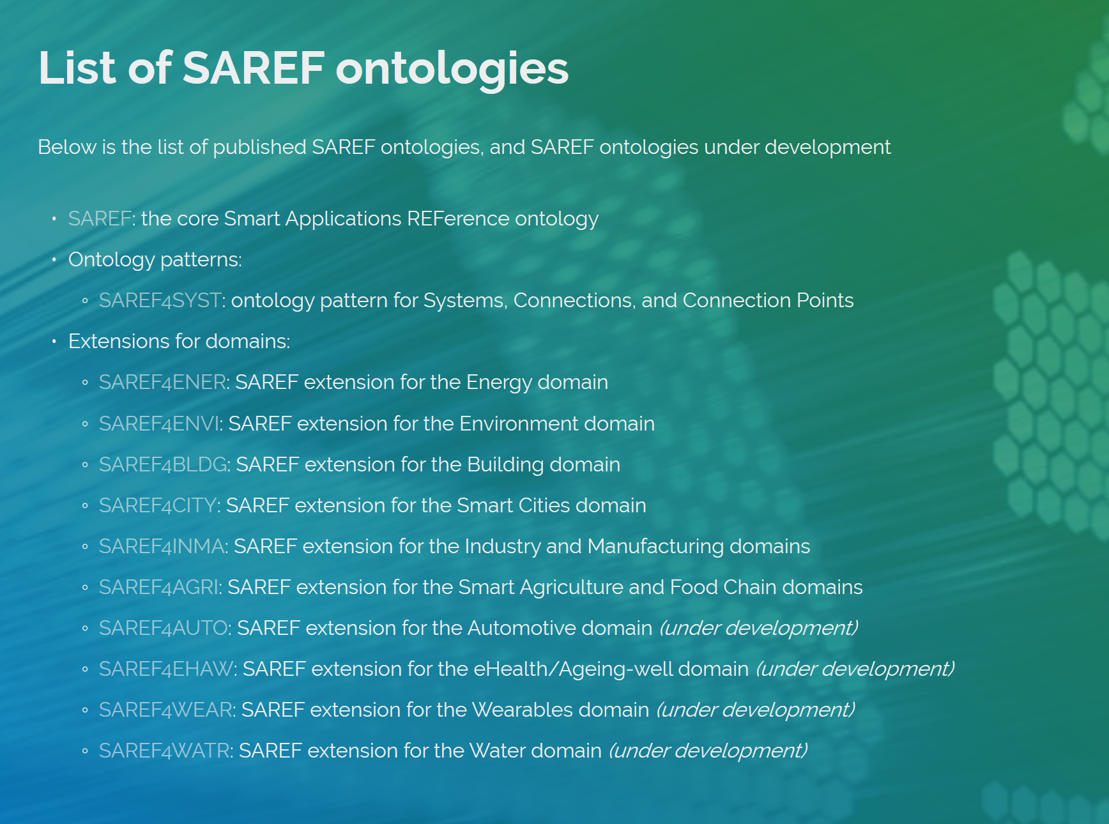
… and is also a core ontology with 10
extensions in different domains
https://saref.etsi.org/extensions.html
The SAREF public portal, the SAREF sources with continuous integration and deployment, the SAREF Pipeline software, and ETSI Technical Specification TS 103 673 v1.1.1 “SAREF Development Framework and Workflow, Streamlining the Development of SAREF and its Extensions", have been developed in the context of the ETSI STF 578, which followed the ETSI STF 556

Slide 21
Some extensions
of interest
for the LDAC community

Slide 22
SAREF4BLDG - General information
SAREF4BLDG was created based on the Industry Foundation Classes (IFC) standard for building information. Not the whole standard has been transformed, the scope of this extension is limited to devices and appliances within the building domain
The IFC specification is developed and maintained by building SMART International as its “Data standard” and, since its version IFC4, it is published as the ISO 16739 standard
More info on current specification of SAREF4BLDG can be found at https://saref.etsi.org/extensions.html#SAREF4BLDG
SAREF4BLDG: Extension for the building domain
IRI: https://saref.etsi.org/saref4bldg/
ETSI Technical Specification: ETSI TS 103 410-1 V1.1.2 (2020-05): “SmartM2M; Extension to SAREF; Part 3: Building Domain”
Sources: https://saref.etsi.org/sources/saref4bldg
All versions
V1.1.2
Version IRI: https://saref.etsi.org/saref4bldg/V1.1.2/
ETSI Technical Specification: ETSI TS 103 410-3 V1.1.2 (2020-05): “SmartM2M; Extension to SAREF; Part 3: Building Domain”
V1.1.1
ETSI Technical Specification: ETSI TS 103 410-3 V1.1.1 (2017-01): “SmartM2M; Extension to SAREF; Part 3: Building Domain”

Slide 23
SAREF4BLDG - Overview
Source: ETSI TS 103 410-3 V1.1.1

Slide 24
SAREF4ENER - General information
SAREF4ENER has been developed based on the data models of the Energy@Home and EEBUS associations.
More info on the current specification of SAREF4ENER can be found at
https://saref.etsi.org/extensions.html#SAREF4ENER
SAREF4ENER: Extension for the Energy domain
IRI: https://saref.etsi.org/saref4ener/
ETSI Technical Specification: ETSI TS 103 410-1 V1.1.2 (2020-05): “SmartM2M; Extension to SAREF; Part 1: Energy Domain”
Sources: https://saref.etsi.org/sources/saref4ener/
All versions
V1.1.2
Version IRI: https://saref.etsi.org/saref4bldg/V1.1.2/
ETSI Technical Specification: ETSI TS 103 410-1 V1.1.2 (2020-05): “SmartM2M; Extension to SAREF; Part 1: Energy Domain”
V1.1.1
ETSI Technical Specification: ETSI TS 103 410-1 V1.1.1 (2017-01): “SmartM2M; Extension to SAREF; Part 1: Energy Domain”

Slide 25
SAREF4ENER: Overview
Saref:Device
Serf: Has profile
Saref:Profile
S4ener:Device
S4ener: Belongs to
S4ener: Exposes
S4ener:Power Profile
S4ener: Has device
S4ener: Belongs to
Serf: Consist of
S4ener: Alternative Group
S4ener: Belongs to
S4ener: State
Saref: Price
Saref: Energy
(“S4ener: Running”,
“S4ener : Paused”,
“S4ener : Scheduled”,
“S4ener : Scheduled Paused”,
“S4ener : Pending”,
“S4ener : Inactive”,
“S4ener : Completed”,
“S4ener : Invalid”,
S4ener: Resume Cost Estimated
S4ener
S4ener: Power Sequence State
Serf: Has state
Serf:
Consist of
Serf: Has price
S4ener: Has Energy
S4ener: Resume Energy Estimated
S4ener:Energy
Saref: Power
owl:one Of
S4ener: Power Sequence
Serf: Consist of
S4ener: Slot
S4ener: Has Energy Value Type
Saref: Power
S4ener: Belongs to
S4ener: Has Power Value Type
S4ener: Elapse Slot Time
S4ener: Start Time
S4ener: Remaining Slot Time
S4ener: Earliest Start time
S4ener: Remaining Pause Time
S4ener: Active Duration Max
S4ener: End Time
S4ener: Default Duration
S4ener: Duration Uncertainty
S4ener: Active Duration Min
S4ener: Latest End Time
S4ener: Active Duration Sum Max
S4ener: Pause Duration Max
S4ener: Min Duration
S4ener: Active Duration Sum Min
S4ener: Pause Duration Min
S4ener: Max Duration
S4ener: Receives
S4ener:Load Control Event Action
S4ener:Load Control Event Data
Time: Temporal Enitity
S4ener:Event Action Consume
S4ener: Trigger Event Action Consume
S4ener” Time Period
Owl: Oneof
S4ener: Has Applied Event Action Consume
S4ener: Has Applied Event Action Produce
Saref: has time
(“S4ener: Pause”,
“S4ener : Resume”,
“S4ener : Reduce”,
“S4ener : Increase”,
“S4ener : Emergency”,
“S4ener : Normal”,
S4ener:Event Action Produce
S4ener: State
Owl: Oneof
S4ener: Has Applied Event Action Produce
S4ener: Load Control Event State
(“S4ener: Event Accepted”,
“S4ener : Event Started”,
“S4ener : Event Stopped”,
“S4ener : Event Rejected”,
“S4ener : Event Cancelled”,
“S4ener : Event Error”,
S4ener: Load Control State Data
S4ener: Event State produce
owl:one Of
s4ener: has Event State Consume
S4ener: Event State Consume
owl:one Of
Source: ETSI TS 103 410-1 V1.1.1

Slide 26
SAREF4CITY - General information
More info on the current specification of SAREF4CITY can be found at https://saref.etsi.org/extensions.html#SAREF4CITY
SAREF4CITY requirements Technical Report (September 2018): TR 103 506
SAREF for City (SAREFCITY) Technical Specification (May 2020): TS 103 410-4
SAREF4CITY: Extension for the Smart Cities domain
IRI: https://saref.etsi.org/saref4city/
ETSI Technical Specification: ETSI TS 103 410-4 V1.1.2 (2020-05): “SmartM2M; Extension to SAREF; Part 4: Smart Cities Domain”
Sources: https://saref.etsi.org/sources/saref4city/
All versions
V1.1.2
Version IRI: https://saref.etsi.org/saref4city/V1.1.2/
ETSI Technical Specification: ETSI TS 103 410-4 V1.1.2 (2020-05): “SmartM2M; Extension to SAREF; Part 4: Smart City Domain”
V1.1.1
ETSI Technical Specification: ETSI TS 103 410-4 V1.1.1 (2017-01): “SmartM2M; Extension to SAREF; Part 4: Smart Cities Domain”

Slide 27
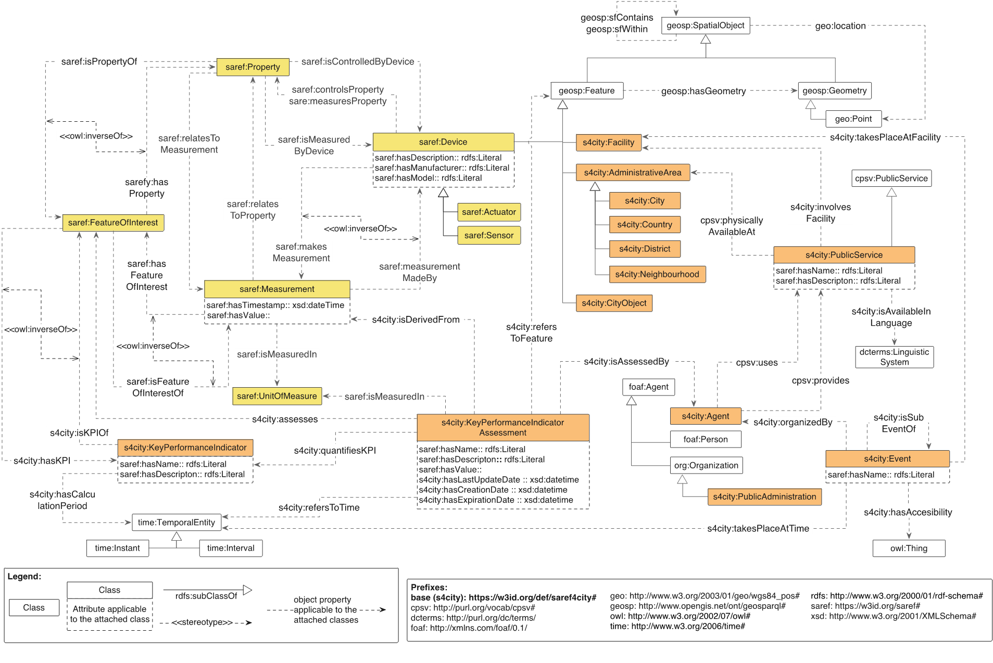
SAREF4CITY - Overview
Source: ETSI TS 103 410-4 V1.1.1

Slide 28
Back to the question…
what is SAREF?

Slide 29
The way I prefer to show how SAREF looks like is …
Who is SAREF?

Slide 30
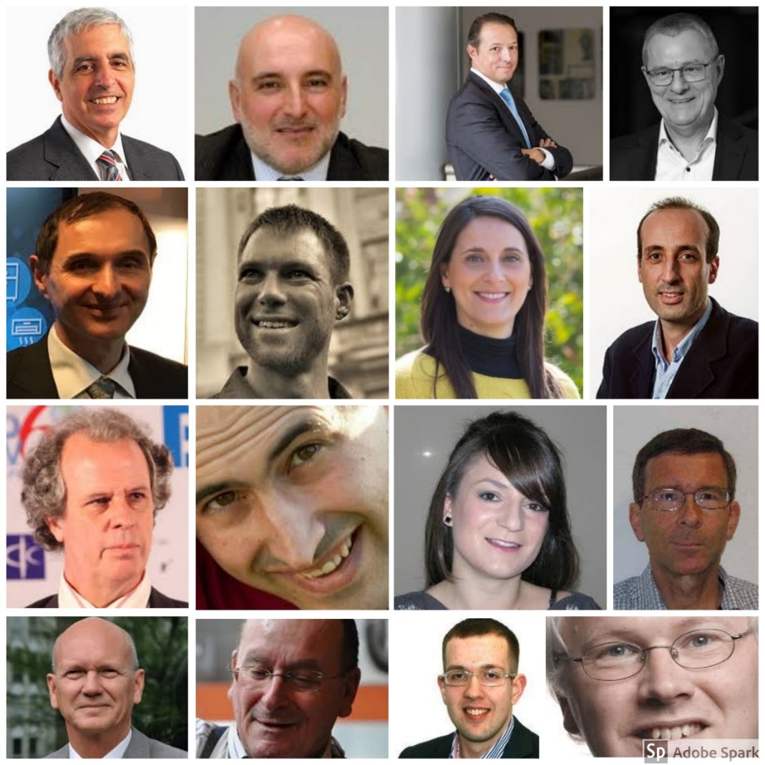

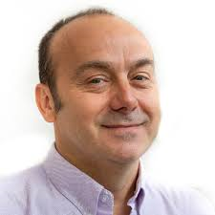
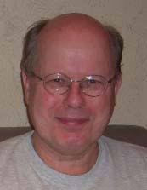
… SAREF is people!
Committed, driven, passionate people
I used a free tool that allows a limited number of pics…and I had limited time to browse for people’s pics on the web…but there are many more faces behind SAREF than the ones you
can see here!

Slide 31
People that together went through
a long way…
SMART 2013/007 study launched by European Commission & ETSI TC SmartM2M
Agreed semantics for smart appliances
Build a reference ontology
STF 534 (ETSI TC SmartM2M & European Commission)
Publication of 3 new SAREF extensions (SAREF4CITY, SAREF4INMA, SAREF4AGRI)
STF 556 (ETSI TC SmartM2M & European Commission)
SAREF publication framework: a uniform documentation website for SAREF and its extensions (prototype)
Publication of SAREF (v1) as ETSI
TS 103 264
STF 513 (ETSI TC SmartM2M & EC)
Publication of first 3 SAREF extensions (SAREF4ENER, SAREF4ENVI, SAREF4BLDG)
2013
2015
2017
2018
2019
2014
2016
Updated version of SAREF (v2)
2017
2020
SMART 2013/0077 study conducted by TNO
SMART 2016/0082 interop demo DSF @European Commission based on SAREF4ENER
Updated version of SAREF (v3)
SAREF → Smart Applications REFerence ontology (not anymore Smart Appliances REFerence ontology)
STF 566 (European Commission & ETSI EC SmartM2M)
Publication of 4 new SAREF extensions (SAREF4Automotive, SAREF4Water, SAREF4Health, SAREF4Wearables)
STF 578 (ETSI TC SmartM2M & European Commission)
SAREF community portal (https://saref.etsi.org/)
Follow-up SMART 2016/0082 study launched by European Commission:
Interoperability for Demand Side Flexibility (DSF)
Adapted from UPM, image by Raul Garcia Castro & Maria Poveda-Villalon
Notes:
6

Slide 32

…a way that was everything
but straight!
Image Retrieved from https://fitterest.com

Slide 33
… towards which destination?
2013
Seven years after the first study lunched by the EC, SAREF is
a series of technical specifications published by the European Telecommunication Standardization Institute (ETSI)
consisting of a modular framework that comprises a generic core ontology for IoT and 10 domain-specific extensions, including SAREF for Energy, Buildings and Cities, which are of particular interest for the LDAC community
The SAREF framework is maintained and evolved by experts from several European organizations that successfully collaborate with each other and can count on the continuous support of ETSI and the European Commission
One of the latest supported initiatives is the development of an ETSI open portal for the SAREF community and industry stakeholders, so that they can contribute directly to the SAREF evolution
Still not the final destination, only a new beginning!

Slide 34
Curiosity

Slide 35
Back in 2015 …
One of the main questions after the creation of the first version of SAREF was about its maintenance, versioning, extension and governance. Some excerpts from a publication of 2015*
Need for user-friendly solution to promote the adoption of SAREF and allow third-party developers and users to utilize the ontology
Need for suitable mechanisms to define SAREF extension and maintenance workflow, manage SAREF extensions and changes submitted by its users, possibly exploiting state-of-the art versioning and consistency checking
Which organization(s) should be responsible for the maintenance, extension and governance of the SAREF network of ontologies?
We believe that the maintenance of SAREF should be delegated to a single party (e.g., an individual organization or a group of organizations) who should also take care of aligning SAREF with new ontologies in the network when necessary
Which organization is going to implement the necessary updates and create the new versions of SAREF? TNO? EC? ETSI? Industrial stakeholders who have closely collaborate as domain experts? New parties (e.g., W3C?)
*Daniele L., den Hartog F., Roes J. (2016) How to Keep a Reference Ontology Relevant to the Industry: A Case Study from the Smart Home. In: Tamma V., Dragoni M., Gonçalves R., Ławrynowicz A. (eds) Ontology Engineering. OWLED 2015. Lecture Notes in Computer Science, vol 9557. Springer, Cham

Slide 36
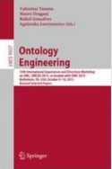
How to keep a reference Ontology relevant to the industry:
A case study from the smart home
Authors
Laura Daniele, Frank den Hartog, Jasper Roes
2020
Conference paper
First online: 20 April 2016
2015
One of the latest supported initiatives is the development of an ETSI open portal for the SAREF community and industry stakeholders, so that they can contribute directly to the SAREF evolution
Part of the Lecture Notes in computer Science book series (LNCS, volume 9557)
International Experiences and Directions on OWL Owled 2015:Ontology Engineering pp117-123
Abstract
The Smart Appliance Reference ontology (SAREF) is a shared model of consensus developed in close interaction with the industry to enable semantic interoperability for smart appliances. Smart appliances are intelligent and networked devices that accomplish some household functions, such as cleaning or cooking. This paper focuses on specific aspects of SAREF’s development cycle, such as the design principles on which the ontology is based and the stakeholders’ requirements from which certain modelling decisions originated. Moreover, we discuss the work to be done in the immediate future for SAREF to evolve concerning its maintenance, versioning, extension and governance. Open questions include how to guarantee the correct usage of SAREF, how to systematically manage the growth of extensions and specializations of SAREF in a consistent network of ontologies, and who should be responsible for these activities

Slide 37
2015
An additional and essential point of discussion concerns who should be responsible for the extension of SAREF, its maintenance and, more in general, the governance of the envisioned network of ontologies. Not only SAREF, but also the network of ontologies needs to be maintained in order to identify and correct defects, accomodate new requirements, and cope with changes overtime. In principle, anybody can create a new ontology that makes use of SAREF and the creator of such ontology is responsible for its maintenance and versioning, independent from SAREF. In this way, the maintenence of the network will be distributed over the creators of the new ontologies sprouting from SAREF. To avoid inconsistency and confusion, we in contrast believe that the maintenance of SAREF should be delegated to a single party (E.g., and individual organization or a group of organizations) who should also take care of aligning SAREF with new ontologies in the network when necessary. Consider, for example, the casr in which several extensions, like the one created for EEBus and Energy@home, are developed to accomodate different use cases, but present common recurringconcepts or properties that could be “Promoted” as core-upper concepts in SAREF. Which organization is going to implement the necessary updates and create the new version of SAREF? TNO could be a natural candidate as the creator of thr=e first version of SAREF, but it is the EC who is the official ownwr of SAREF, ETSI is given the responsibilty to adopt SAREF as a Technical Specification (TS) [8], and a large number of industrial stakeholders have closely collaborates as domain experts in SAREF’s development. Also new parties such as W3C could play a role
2020
ETSI STF 578: The value of SAREF is strongly correlated with the size of its community of users, and also to the agility of the SAREF developers to improve the SAREF ontology and react to raised issues. As such, SAREF users’ community and the industry actors need be attracted to SAREF with clear Web documentation and a clear indication about how to provide
their input and the kind of input that they
can provide
https://portal.etsi.org/STF/STFs/STF-HomePages/STF578
We concluded that there is a need for flexible and user-friendly solutions to further promote the adoption of SAREF allow third-party developers and users to utilize the ontology, either the whole model or a relevant subset of it. Moreover, we identified the need for suitable mechanisms to define the SAREF extension and maintenance workflow, manage SAREF extensions and changes submitted by its users, possibly exploiting state-of-the-art versioning and consistency checking. The question of which organization(s) should be responsible for the maintenance, extension and governance of the SAREF network of ontologies remains open and needs special attention in the immediate future

Slide 38
Some lessons learned

Slide 39
What made SAREF a successful story (I)
SAREF started with the vision of some people
  Clear vision, even if lots of things changed on the way (for example, people) the vision helped to keep focus
  Step by step approach, project by project, believing in the vision
It was a need, an explicit request from the industry
  Close interaction with the industry
  Built bottom up from existing data models, protocols and standards
  Iterative and interacting approach. It introduced overhead (more interactions and work for experts), but guaranteed a result that better reflected the wishes of the community. It created trust in our work, increasing changes of strong acceptance of the results
It engaged more and more people on the way
  Stakeholders from various domains
  New experts that believed in the vision
  People are the main asset

Slide 40
What made SAREF a successful story (II)
It got the support of the standardization world already at an early stage
  Unfortunately, a rich and expressive formal ontology that allows full reasoning does not guarantee its adoption by the industry
  In contrast, a real, strong demand from the market combined with the enforcement of a standard by policy makers (European Commission) helps a lot
  A new, dynamic standardization process was necessary to deal with the SAREF framework of ontologies, which are ongoing, living models that evolve over time, getting often improved and updated
  Clear documentation and automation of the ontology creation/standardization process is crucial for adoption
Creation of consensus is fostered by a neutral party
  SAREF experts (TNO, UPM, MINES Saint-Étienne) are neutral parties, not seen as competitor in the market
Clear process for maintenance and evolution should be taken into account since the beginning

Slide 41
What’s next towards
the destination?

Slide 42
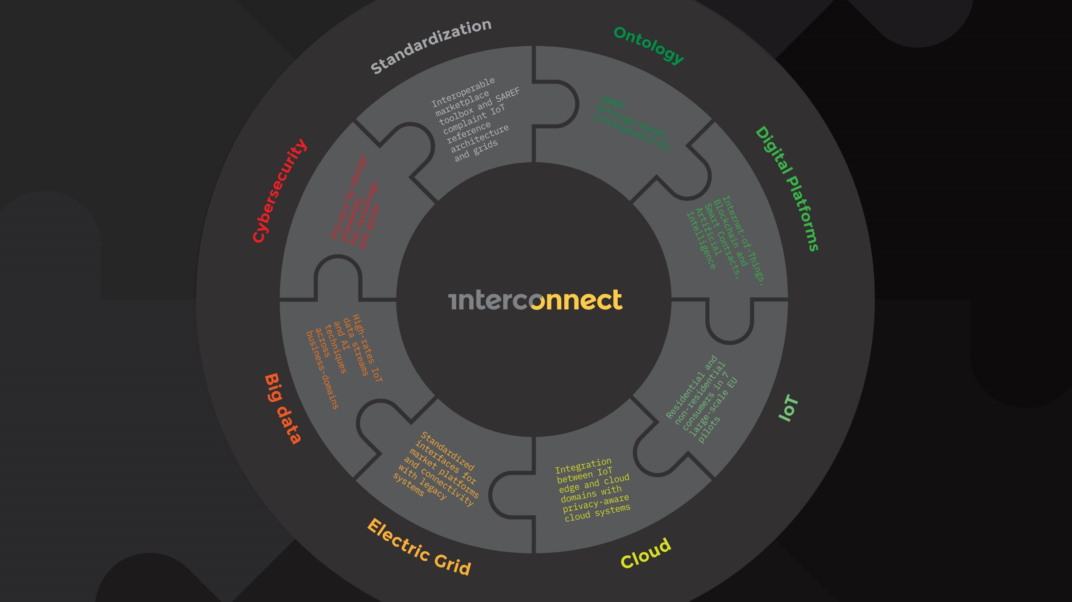
H2020 InterConnect Large Scale Pilot
Duration 2019-2023
interoperable solutions connecting smart homes, buildings and grids
https://interconnectproject.eu/

Slide 43
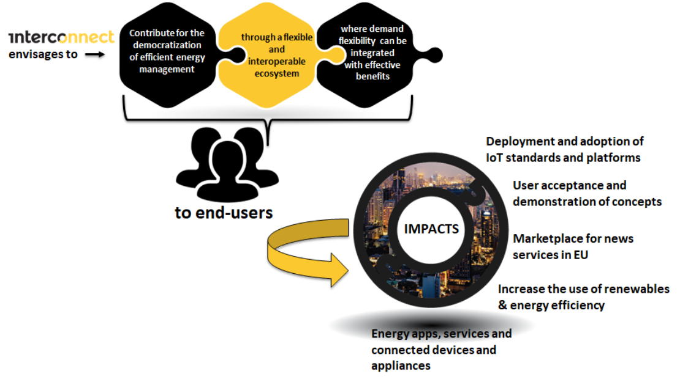
What are our goals?

Slide 44
… and expected outputs?
Standardization Recommendations to SDO (CEN/CENELEC,ETSI,AIOTI, IEEE, IEC, etc.)
Improved customer Energy Management by combining IoT with design thinking/co-creation
Domain Interoperable IoT Reference Architecture: Mix of ontologies, standards, abstraction layers, security concepts
Digital Marketplace and Interoperability Toolkit articulating different digital platforms (P2P, blockchain, IOT,etc.)
Interconnect
Outputs
Interoperable Functional Components for Residential and Non-residential Buildings: SAREF ontology-based interoperability
Interoperable and Replicable DSO Interface for energy and flexibility market places
Business use cases
for new energy and non-energy services

Slide 45
How will we achieve it?
By developing technologies in two main areas
Energy
management
systems
Big
data
Smart
grid
systems
Energy
Advanced
electric
vehicles
charging
Blockchain
ICT
P2P
Smart
Buildings
and smart
appliances
Cloud
computing
Privacy
preserving
functionalities

Slide 46

What impacts do we expect achieve?
Deployment and adoption of IoT standards and platforms
User acceptance and demonstration of concepts
Accelerate a wider deployment and adoption of IoT standards and platforms in smart homes and buildings in Europe and development of secure, cost-effective and sustainable IoT ecosystems and related business models
Validation of end user acceptance, as well as demonstration of viable concepts that ensure privacy, liability and trust in connected data spaces
Marketplace for news services in EU
Impacts
Demonstrate that IoT platforms lead to a marketplace for new services in EU homes and buildings with opportunities for SMEs and start-ups
Energy apps, services and connected devices and appliances
Increasing number of energy apps, services - energy (ex: building energy efficiency, electrical mobility, renewable integration) and non-energy (comfort, convenience, security, privacy) - and connected devices and appliances
Increase the use of renewables & energy efficiency
Contribute to increase the use of renewables and energy efficiency, offering access to cheaper and sustainable energy for consumers and maximising social welfare

Slide 47
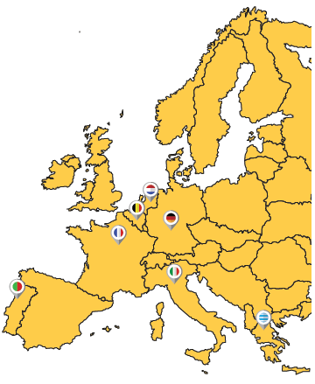
Seven large scale pilots leading to market driven deployments will be installed
The future of smart energy management solutions will start by testing seven connected large-scale pilots across Europe:
  Greece
    Large residential community with smart appliances and EV integration
  France
    Residential & non-residential, with tertiary buildings and apartments
  Portugal
    Residential & geographically widespread tertiary buildings
  Netherlands
    Residential & non-residential buildings
  Germany
    Groups of residential buildings and hotels
  Belgium
    Residential and tertiary buildings in communities of multi-energy vectors
  Italy
    Residential social housing

Slide 48












































The consortium is composed by 50 members
covering full IoT & energy value chain
R&D
Consultancy
Manufacturers
Associations
IoT/ICT Providers
DSOs
Retailers
End-User

Slide 49
Our milestones
2019
2020
2021
2022
2023
Use cases, business models and services
Services and business use cases identified
Assessment of functional and non-functional requirements finalized
Domain interoperable IoT
references architecture
Architecture, related standards and ontologies documented
Semantically interoperable components, applications and devices for smart homes and buildings
Components SAREFized and integrated in Digital Platforms
Smart grids framework for an interoperable energy system
Standardized DSO interface ready for testing in pilots
DSO flexibility platform available for testing in pilots
Digital platform and marketplace
Catalogue of digital platforms, services and systems available
Interoperable marketplace toolbox and enablers ready for pilots
Preparation, coordination and monitoring of pilots
Field tests are up and running
Large-scale demonstration and integration of solutions
Demonstrated solutions and use cases.
Results communicated to several stakeholders
Sustainability of the interconnect project
InterConnect community Launched
Impact assessment concluded and recommendations available

Slide 50
We will also support Cascading initiatives
Besides the developments that will be conducted by the 50 partners of the consortium, the project will also foster innovation to expand the ecosystem of players by offering opportunities for entrepreneurs through open calls.
3 open calls will be launched to select 42 innovative bottom-up projects—14 prototypes and 28 small—demonstrators
The open calls will be launched in 2022. In 2023 the prototypes and small—demonstrators will be executed

Slide 51
Challenges ahead

Slide 52
Questions and challenges: just to mention a few…(I)
What are the questions and challenges when concretely using (the SAREF framework of) ontologies to develop large scale applications? Especially when going across-domain, like the Interconnect project aims to do, by combining the different domains of smart homes, buildings and grids?
  Each domain (smart homes, buildings and grids) is an already mature domain that evolved in parallel, from different requirements, different communities, creating different standards, based on different architectures, etc. Combining is a huge challenge!
    See, for example, the challenge of defining a reference architecture that harmonizes existing IoT reference architectures with Energy architectures, while also incorporating semantic components to allow full exploitation of the reasoning capabilities associated with the ontologies
  New added-value services for the users arising from data integration (using the SAREF framework of ontologies), but what are the business models? Marketplace for new services in EU to create opportunities for SMEs and start-ups: what is it in practice and how does it look like?
  Security and privacy by design. Where to best address these concerns? At the level of the ontology? At the level of the underlying communication platforms? At both levels?

Slide 53
Questions and challenges: just to mention a few…(II)
Ontologies are perceived by stakeholders as a useful tool for interoperability, but still stakeholders do not understand them in practice
How to use (the SAREF framework of) ontologies and related standards (e.g., RDF, OWL, SPARQL etc.) with their existing platforms? Is SAREF to be used at the device level? And/or on a gateway? Can it be used also at the service level?
How to avoid to create a new (Interconnect) platform yet on top of the existing ones, but rather connect the existing platforms in a distributed fashion?
How to avoid that stakeholders have to change their solutions (often not even feasible), but rather minimally adapt, for example by adding “smart connectors” to access the semantic interoperability layer and benefit from the ontologies? How these smart connectors would look like?

Slide 54
Questions and challenges: just to mention a few…(III)
Aim of Interconnect is to develop a new, improved version of SAREF4ENER (and contributions to other extensions, if needed), involving more stakeholders in the energy/ building ecosystem compared to the first version
  Consensus and agreement among many more stakeholders is therefore needed (challenging), but this effort will result into a better ontology and a broader adoption
  From a technical point of view, what level of detail to reach in these extensions? Would a modular version of SAREF4ENER help to better address different concerns from different stakeholders?
SAREF is about sensors and actuators. Ontologies are traditionally beneficial to ask queries, especially complex ones that could not be answered without an ontology. They are definitely useful for discovering and reasoning about sensor’s data, but what about actuators that also involve control of devices (not only querying). How to implement control with SAREF and ontologies in general?
Smart Readiness Indicator (SRI) for Buildings, Interoperability and SAREF: can they be used together? Can SAREF be used to assess the interoperability aspect of the SRI? If so, how? If not, what is missing and what is the way forward?

Slide 55
Takeaway

Slide 56
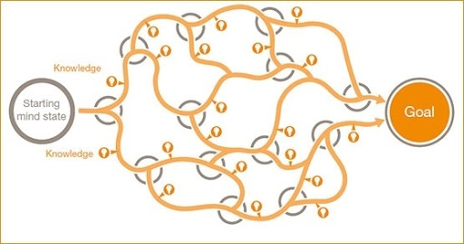
Multiple paths to the destination: the SAREF journey
Key takeaway
  Vision of the goal to achieve in the long term (final destination) is essential
  Keep the vision in mind, it will take time and so much in the environment will change (e.g., some people may leave and other will join) but the final destination will still be the guiding reference
Start
Short term goal
  It is OK not to have a path planned into details to reach the final destination, as it does not really matter which path one takes. What is important is a clear step towards the (next) short term goal(s), as it will bring one step forward to the final goal
  Patience, perseverance and confidence: set short terms goals, step by step, will get there!
  Collaborating with people is awesome! Magic things happen when one shares the journey with others

Slide 58
Backup slides SAREF extensions

Slide 59
SAREF overview
Smart Applications REFerence ontology (SAREF)
https://saref.etsi.org/
Source: ETSI TS 103 264 V3.1.1

Slide 60
SAREF4BLDG

Slide 61
SAREF4BLDG - General information
SAREF4BLDG was created based on the Industry Foundation Classes (IFC) standard for building information. Not the whole standard has been transformed, the scope of this extension is limited to devices and appliances within the building domain
The IFC specification is developed and maintained by building SMART International as its “Data standard” and, since its version IFC4, it is published as the ISO 16739 standard
More info on current specification of SAREF4BLDG can be found at https://saref.etsi.org/extensions.html#SAREF4BLDG
SAREF4BLDG: Extension for the building domain
IRI: https://saref.etsi.org/saref4bldg/
ETSI Technical Specification: ETSI TS 103 410-1 V1.1.2 (2020-05): “SmartM2M; Extension to SAREF; Part 3: Building Domain”
Sources: https://saref.etsi.org/sources/saref4bldg
All versions
V1.1.2
Version IRI: https://saref.etsi.org/saref4bldg/V1.1.2/
ETSI Technical Specification: ETSI TS 103 410-3 V1.1.2 (2020-05): “SmartM2M; Extension to SAREF; Part 3: Building Domain”
V1.1.1
ETSI Technical Specification: ETSI TS 103 410-3 V1.1.1 (2017-01): “SmartM2M; Extension to SAREF; Part 3: Building Domain”

Slide 62
SAREF4BLDG - Overview
Source: ETSI TS 103 410-3 V1.1.1
Figure by Maria Poveda-Villalon & Raul Garcia Castro (UPM)

Slide 63
SAREF4BLDG: Device Types (I)
Saref: Device
BuildingObject
BuildingDevice
DistributionDevice
DistributionControlDevice
Actuator
Saref: Actuator
Alarm
Controller
ProtectiveDeviceTrippingUnit
Flowintrument
Sensor
Saref: Sensor
UnitaryControlElement
DistributionFlowDevice
EnergyConversionDevice
FlowController
FlowMovingDevice
FlowStorageDevice
FlowTerminal
FlowTreatmentDevice
ShadingDevice
TransportElement
VibrationIsolator
Source: ETSI TS 103 410-3 V1.1.1
Adapted from figure by Maria Poveda-Villalon & Raul Garcia Castro (UPM)

Slide 64
SAREF4BLDG: Device Types (II)
DistributionFlowDevice
EnergyConversionDevice
FlowController
FlowMovingDevice
FlowStorageDevice
FlowTerminal
FlowTreatmentDevice
AirToAirHeatRecovery
Damper
Compressor
ElectricFlowStorage
Device
AudioVisualAppliance
DuctSilencer
Boiler
ElectricTimeControl
Fan
CommunicationAppliance
Filter
Burner
FlowMeter
Pump
Tank
ElectricAppliance
Interceptor
Chiller
ProtectiveDevice
FireSuppressionTerminal
Coil
SwitchingDevice
Condenser
Valve
Lamp
CooledBeem
MedicalDevice
CoolingTower
Outlet
ElectricGenerator
SanitaryTerminal
ElectricMotor
SpaceHeater
Engine
EvaporativeCooler
Evaporator
HeatExchange
Humidifier
SolarDevice
Transformer
TubeBundle
Source: ETSI TS 103 410-3 V1.1.1
Adapted from figure by Maria Poveda-Villalon & Raul Garcia Castro (UPM)

Slide 65
SAREF4BLDG – example (I)
Saref: Measurement
Saref: UnitOfMeasure
S4bldg: Compressor
“SIEMENS”^^ xsd: string
Saref: hasValue
“3.0”^^xsd: float
S4bldg: comparessorSpeed
Ex: CompressorSpeedCompressor001SIERRA02-0434C3
“Compressor001 SIERRA 02-0434C3”^^xsd: string
Saref: isMeasredln
Ex: cyclesPerSecond
Saref: hasName
Saref: hasManufacturer
Saref: hasValue
“1800.0”^^xsd: float
S4bldg: ideal
Capacity
Ex: IdealCapacityCompressor001SIERRA02-0434C3
Ex: Compressor001SIERRA02-0434C3
Saref: PowerUnit
Saref: isMeasredln
om: watt
S4bldg: power
Source
Saref: isMeasredln
S4bldg:
nonimal
Capacity
Ex: NominalCapacityCompressor001SIERRA02-0434C3
Saref: hasValue
“680.0”^^xsd:float
S4bldg: refrigerantClass
S4bldg: hasHot
GasBypass
Saref: hasValue
“5.9”^^xsd:float
S4bldg: impellerDiameter
Ex: ImpellerDiameterCompressor001SIERRA02-0434C3
“HFC”^^xsd: string
“false”^^xsd: boolean
Saref: ismeasuredln
om: inch-international
“MotorDriven”^^xsd: string
Source: ETSI TS 103 410-3 V1.1.1
Adapted from figure by Maria Poveda-Villalon & Raul Garcia Castro (UPM)

Slide 66
SAREF4BLDG – example (II)
S4bldg: Compressor
Geo: SpatialThing
Ex: Compressor001SIERRA02-0434C3
Geo: latitude
40.405013
S4bldg: isContainedln
Ex: LocationComputer
ScienceBuilding1
S4bldg: Building
Geo: longitude
-3.839349
Ex: ComputerScienceBuilding1
Geo: Location
S4bldg: BuildingSpace
Geo: latitude
40.405152
S4bldg: isSpaceOf
Ex: LocationRefrigerationStore
ComputerScienceBuilding1
Ex: RefrigerationStoreComputer
ScienceBuilding1
Geo: longitude
-3.839209
Geo: location
Geo: latitude
40.405155
Geo: location
Ex: LocationCompressor
001SIERRA02-0434C3
Geo: longitude
-3.839203
Source: ETSI TS 103 410-3 V1.1.1
Adapted from figure by Maria Poveda-Villalon & Raul Garcia Castro (UPM)

Slide 67
SAREF4BLDG – example (III)
S4bldg: Compressor
Saref: PowerUnit
Ex: Compressor001SIERRA02-0434C3
S4ener: PowerProfile
S4ener: Power
“902.0”^^xsd: float
Wurvoc: watt
S4ener: exposes
Ex: PowerProfileCompressor
001SIERRA02-0434C3
Ex: PowerCompressor001SIERRA02-0434C3
Saref: hasValue
Saref: hasComsumption
Saref: isMeasuredln
Source: ETSI TS 103 410-3 V1.1.1
Adapted from figure by Maria Poveda-Villalon & Raul Garcia Castro (UPM)

Slide 68
SAREF4ENER

Slide 69
SAREF4ENER - General information
SAREF4ENER has been developed based on the data models of the Energy@Home and EEBUS associations.
More info on the current specification of SAREF4ENER can be found at
https://saref.etsi.org/extensions.html#SAREF4ENER
SAREF4ENER: Extension for the Energy domain
IRI: https://saref.etsi.org/saref4ener/
ETSI Technical Specification: ETSI TS 103 410-1 V1.1.2 (2020-05): “SmartM2M; Extension to SAREF; Part 1: Energy Domain”
Sources: https://saref.etsi.org/sources/saref4ener/
All versions
V1.1.2
Version IRI: https://saref.etsi.org/saref4bldg/V1.1.2/
ETSI Technical Specification: ETSI TS 103 410-1 V1.1.2 (2020-05): “SmartM2M; Extension to SAREF; Part 1: Energy Domain”
V1.1.1
ETSI Technical Specification: ETSI TS 103 410-1 V1.1.1 (2017-01): “SmartM2M; Extension to SAREF; Part 1: Energy Domain”

Slide 70
SAREF4ENER: Overview
Saref:Device
Serf: Has profile
Saref:Profile
S4ener:Device
S4ener: Belongs to
S4ener: Exposes
S4ener:Power Profile
S4ener: Has device
S4ener: Belongs to
Serf: Consist of
S4ener: Alternative Group
S4ener: Belongs to
S4ener: State
Saref: Price
Saref: Energy
(“S4ener: Running”,
“S4ener : Paused”,
“S4ener : Scheduled”,
“S4ener : Scheduled Paused”,
“S4ener : Pending”,
“S4ener : Inactive”,
“S4ener : Completed”,
“S4ener : Invalid”,
S4ener: Resume Cost Estimated
S4ener
S4ener: Power Sequence State
Serf: Has state
Serf:
Consist of
Serf: Has price
S4ener: Has Energy
S4ener: Resume Energy Estimated
S4ener:Energy
Saref: Power
owl:one Of
S4ener: Power Sequence
Serf: Consist of
S4ener: Slot
S4ener: Has Energy Value Type
Saref: Power
S4ener: Belongs to
S4ener: Has Power Value Type
S4ener: Elapse Slot Time
S4ener: Start Time
S4ener: Remaining Slot Time
S4ener: Earliest Start time
S4ener: Remaining Pause Time
S4ener: Active Duration Max
S4ener: End Time
S4ener: Default Duration
S4ener: Duration Uncertainty
S4ener: Active Duration Min
S4ener: Latest End Time
S4ener: Active Duration Sum Max
S4ener: Pause Duration Max
S4ener: Min Duration
S4ener: Active Duration Sum Min
S4ener: Pause Duration Min
S4ener: Max Duration
S4ener: Receives
S4ener:Load Control Event Action
S4ener:Load Control Event Data
Time: Temporal Enitity
S4ener:Event Action Consume
S4ener: Trigger Event Action Consume
S4ener” Time Period
Owl: Oneof
S4ener: Has Applied Event Action Consume
S4ener: Has Applied Event Action Produce
Saref: has time
(“S4ener: Pause”,
“S4ener : Resume”,
“S4ener : Reduce”,
“S4ener : Increase”,
“S4ener : Emergency”,
“S4ener : Normal”,
S4ener:Event Action Produce
S4ener: State
Owl: Oneof
S4ener: Has Applied Event Action Produce
S4ener: Load Control Event State
(“S4ener: Event Accepted”,
“S4ener : Event Started”,
“S4ener : Event Stopped”,
“S4ener : Event Rejected”,
“S4ener : Event Cancelled”,
“S4ener : Event Error”,
S4ener: Load Control State Data
S4ener: Event State produce
owl:one Of
s4ener: has Event State Consume
S4ener: Event State Consume
owl:one Of
Source: ETSI TS 103 410-1 V1.1.1
Figure by Laura Daniele (TNO)

Slide 71
Power Profile, Alternatives Group,
Power Sequence and Slot
A power profile is a way to model curves of power and energy over time, which also provides definitions for the modelling of power scheduling including alternative plans. With a power profile, a device (or power sequences server) exposes the power sequences that are potentially relevant for the CEM (or power
sequences client)
An alternatives group is a collection of power sequences for a certain
power profile
A power sequence is the specification of a task, such as wash or tumble dry, according to user preferences and/or manufacturer's settings for a certain device. It is the most 'coarse' view; a power sequence can represent all single steps of a whole task, where the single steps are represented by slots
A slot is a single step of a power sequence. A slot is associated with a slot number (while a power sequence is associated with a power sequence identifier). The slot numbers of two power sequences should be considered independent from each other, i.e. slot number 7 of sequence 1 describes a different slot than slot number 7 of sequence 2. Therefore, a slot is only uniquely identified in combination with a sequence ID
Source: ETSI TR 103 411 V1.1.1

Slide 72
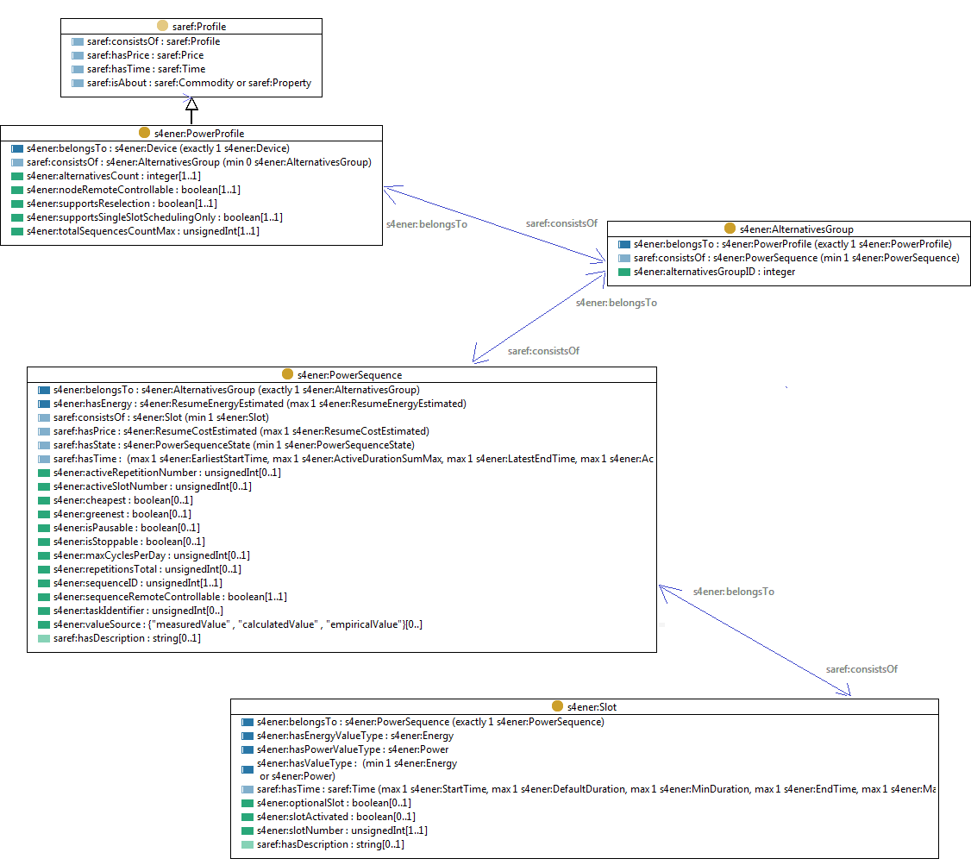
SAREF4ENER: Power Profile
Saref:Profile
Saref:consistsOf:saref:Profile
Saref:hasPrice:saref:Price
Saref:hasTime:saref:Time
Saref:isAbout:saref:Commodity or saref:Property
S4ener:PowerProfile
S4ener:AlternativeGroup
S4ener:belongsTo:s4ener:Device (exactly 1 s4ener:Device)
Saref:consistsOf:s4ener:AlternativesGroup(min 0 s4ener:AlternativesGroup
S4ener:alternativesCount:integer(1..1)
S4ener:nodeRemoteControllable:boolen(1..1)
S4ener:supportsReselection:Boolean(1..1)
S4ener:supportsSingleSlotSchedulingOnly:boolen(1..1)
S4ener:totalSequencesCountMax:unsignedInt(1..1)
S4ener:belongsTo:s4ener:PowerProfile(exactly 1 s4ener:PowerProfile)
Saref:consistsOf:s4ener:PowerSequence (min 1 s4ener:PowerSequence)
S4ener:alternativesGroupID:integer
Saref: consistsOf
Saref: belongs To
Saref: belongs To
S4ener:PowerProfile
S4ener:belongsTo:s4ener:AlternativesGroup(exactly 1 s4ener:AlternativesGroup
S4ener:hasEnergy:4ener:ResumeEnergyEstimated (max 1 s4sener:ResumeEnergyEstimated)
Saref:consistsOf:s4ener:Slot (min 1 s4ener:Slot)
Saref:hasPrice:s4ener:ResumeCostEstimated(max 1 s4ener:ResumeEnergyEstimated)
Saref:hasState:s4ener:PowerSequenceState (min 1 s4ener:PowerSequenceState)
Saref:hasTime: (max 1 s4ener:EarliestStartTime,max 1 s4ener:ActiveDurationSumMax, max1 S4ener:LatestEndTime, max1 s4ener:Ac
S4ener:activeRepetitionNumber:unsignedInt(0..1)
S4ener:activeSlotNumber:unsignedInt(0.11)
S4ener:cheapest:Boolean(0..1)
S4ener:greenest:Boolean(0..1)
S4ener:isPausable:Boolean(0..1)
S4ener:isStoppable:Boolean(0..1)
S4ener:maxCyclesPerDay:unsignedInt(0..1)
S4ener:repetitionsTotal:unsignedInt(0..1)
S4ener:sequqnceID:unsignedInt(1..1)
S4ener:sequenceRemoteControllable:Boolean(1..1)
S4ener:taskIdentifier:unsignedInt(0..)
S4ener:valueSource:{“measuredValue”, “calculatedValue”, “empiricalValue”}(0..)
Saref:hasDescription:string(0..1)
Saref: consistsOf
s4ener: belongsTo
saref: consistsOf
S4ener:Slot
S4ener:belongsTo:s4ener:PowerSequence(exactly 1 s4ener:PowerSequence)
S4ener:hasEnergyValueType:s4ener:Energy
S4ener:hasPowerValueType:s4enerPower
S4ener:hasValueType: (min 1 s4ener:Energy or s4ener:Power)
Saref:hasTime:saref:Time (max 1 s4ener:StartTime, max 1 s4ener:DefaultDuration, max 1 s4ener:MinDuration, max 1 S4ener:EndTime, max 1 s4ener:Max
S4ener:optionalSlot:Boolean(0..1)
S4ener:slotActivated:Boolean(0..1)
S4ener:slotNumber:unsignedInt(1..1)
Saref:hasDescription:string(0..1)
Source: ETSI TS 103 410-1 V1.1.1
Figure by Laura Daniele (TNO)

Slide 73
SAREF4ENER: Example (I)
time:powerSequence-HS0001_morning
Saref:hasTime
s4ener:PowerSequence-1-HS0001
Saref:consistsOf
s4ener:Slot-1-HS0001
Saref:consistsOf
Saref:hasTime
s4ener:StartTime_1
s4ener:hasEnergyValueType
s4ener:Power_1
s4ener:AlternativesGroup-1-HS0001
s4ener:Energy_1
Saref:consistsOf
Saref:hasTime
Saref:isMeasuredByDevice
Saref:isMeasuredByDevice
s4ener:PowerProfile-1-HS0001
s4ener:belongsTo
s4ener:HeatingSystem
Saref:accomplishes
s4ener:PowerSequence-3-HS0001
s4ener:Slot-3-HS0001
s4ener:Heating
Saref:consistsOf
Saref:consistsOf
Saref:consistsOf
Saref:hasTime
Saref:accomplishes
s4ener:AlternativesGroup-2-HS0001
time:PowerSequence-HS0001_afternoon
Saref:hasTime
s4ener:EnergyEfficiency
Saref:consistsOf
Saref:hasTime
s4ener:PowerSequence-2-HS0001
s4ener:Slot-2-HS0001
Saref:consistsOf
Source: ETSI TS 103 410-1 V1.1.1
Figure by Laura Daniele (TNO)

Slide 74
SAREF4ENER: Example (II)
The s4ener:PowerProfile is used by a s4ener:Device to expose potentially relevant power sequences, for example, a heating system with hot water tank that wants to communicate its expected energy consumption for a certain day. The s4ener:HeatingSystem exposes a s4ener:PowerProfile (s4ener:PowerProfile-1-HS0001 instance), which consists of two groups with alternative plans (each group is modelled as a s4ener:AlternativesGroup class). These groups do not overlap in time and allow to model consecutive (and also rather independent) periods of action. For example, the s4ener:PowerProfile-1-HS0001 contains one group of alternatives for a task in the morning, and another group of alternatives for another (additional) task in the afternoon. Within one group, there can be one or more plans represented by s4ener:PowerSequence classes (i.e. s4ener:AlternativesGroup-1-HS0001 and s4ener:AlternativesGroup-2-HS0001) which are alternatives to each other (i.e. at most one of these plans can be finally executed). For example, to charge the hot water tank, the heating system can offer within the "afternoon alternative group" two alternative plans, represented as power sequences: (a) a "cheapest" plan in which the CEM should try to minimize the user's energy bill, and (b) a "greenest" plan in which the CEM should try to optimize the configuration towards the maximum availability of renewable energy
Source: ETSI TR 103 411 V1.1.1

Slide 75
SAREF4ENER: Example (III)
In the afternoon group (s4ener:AlternativesGroup-2-HS0001) the heating system offers two different power sequences: (a) s4ener:PowerSequence-3-HS0001 that aims to run "as cheap as possible" and permits the CEM to shift the start between 8:45 and 12:00, and (b) s4ener:PowerSequence-2-HS0001 that aims to reduce energy (it can even announce the user's preference for "green energy"). This means for the afternoon the CEM can take a choice for the "cheap" or the "green" plan. The plans may have further options with regards to their flexibility. For example one of the plans may offer that the CEM can pause a sequence (as long as the sequence completes before the latest time set by the user). Finally, a s4ener:PowerSequence consists of one or more slots (s4ener:Slot class) that represent different phases of consumption (or production) and their values. The power sequences of the heating system example have a single slot each. However, for other devices such as washing machines, a power sequence may have various slots for the different phases of washing, such as heating the water, washing and rinsing
Source: ETSI TR 103 411 V1.1.1

Slide 76
SAREF4CITY

Slide 77
SAREF4CITY - General information
More info on the current specification of SAREF4CITY can be found at https://saref.etsi.org/extensions.html#SAREF4CITY
SAREF4CITY requirements Technical Report (September 2018): TR 103 506
SAREF for City (SAREFCITY) Technical Specification (May 2020): TS 103 410-4
SAREF4CITY: Extension for the Smart Cities domain
IRI: https://saref.etsi.org/saref4city/
ETSI Technical Specification: ETSI TS 103 410-4 V1.1.2 (2020-05): “SmartM2M; Extension to SAREF; Part 4: Smart Cities Domain”
Sources: https://saref.etsi.org/sources/saref4city/
All versions
V1.1.2
Version IRI: https://saref.etsi.org/saref4city/V1.1.2/
ETSI Technical Specification: ETSI TS 103 410-4 V1.1.2 (2020-05): “SmartM2M; Extension to SAREF; Part 4: Smart City Domain”
V1.1.1
ETSI Technical Specification: ETSI TS 103 410-4 V1.1.1 (2017-01): “SmartM2M; Extension to SAREF; Part 4: Smart Cities Domain”

Slide 78
SAREF4CITY requirements
Parking
Road
Traffic
Requirements:
  EU Metadata Registry
  FEMP Open Data Guide exemplary datasets
  FIWARE data model for KPIs
  ISA Programme Location Core Vocabulary
  Joinup Core Public Organization Vocabulary
  OGC CityGML
  OGC GeoSPARQL
  schema.org
  Vocabulary referenced by AENOR UNE 178301:2015
  W3C Registered Organization Vocabulary
  W3C WGS84 Geo Positioning vocabulary
Transport
U
U
F
E
U
Traffic
F
Tourism
W
Areas of Interest
F
FI
U
City Objects
W
U
E
I
I
G
G
W
Parking
W
Topology and Geometry
C
J
F
F
Traffic
FI
U
C
Facilities
City
Services
G
KPIs
G
F
J
SAREF
S
O
U
Comm.
Premises
U
S
U
O
Events
W
Adapted from figure by Raúl García-Castro and María Poveda-Villalón, Universidad Politecnica de Madrid (UPM), Ontology Engineering group

Slide 79
SAREF4CITY - Overview
Source: ETSI TS 103 410-4 V1.1.1
Figure by Raúl García-Castro and María Poveda-Villalón, Universidad Politecnica de Madrid (UPM)

Slide 80
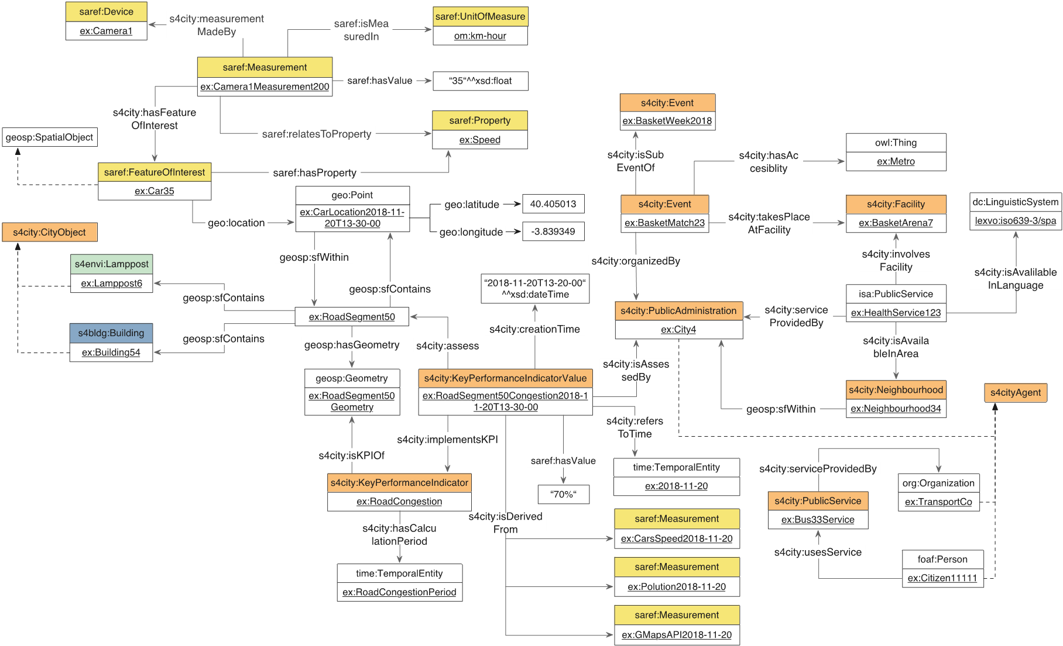
SAREF4CITY – example
Source: ETSI TS 103 410-4 V1.1.1
Figure by Raúl García-Castro and María Poveda-Villalón (UPM)

